Slide 1


Slide 2
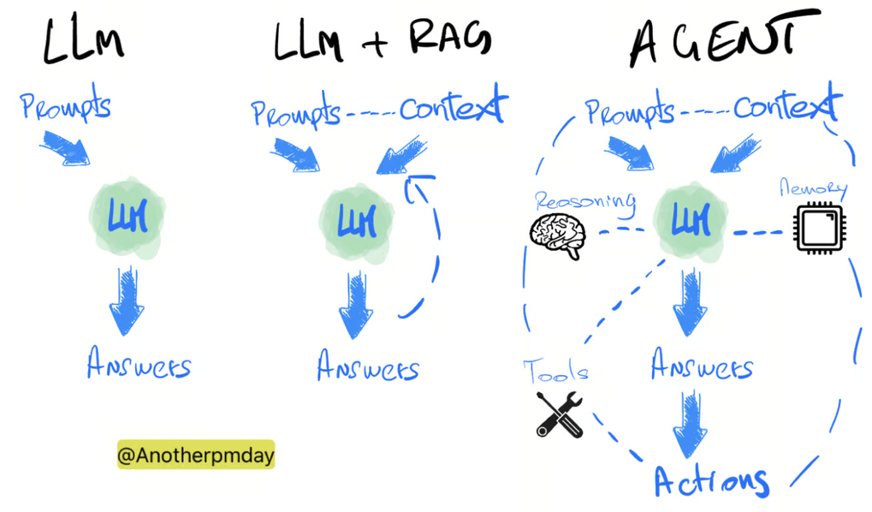
Agentic AI
Notes:
RAG: retrieve relevant, factual context from external data sources to generate answers
AI agent: can retrieve, use and update context from many different types of tools, not only generate answers but also perform actions

Slide 3
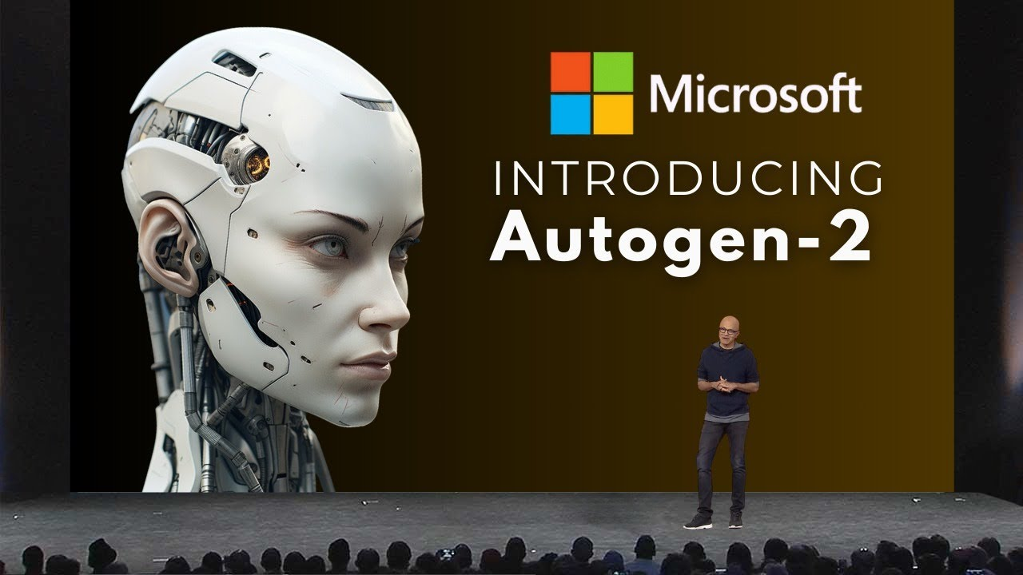


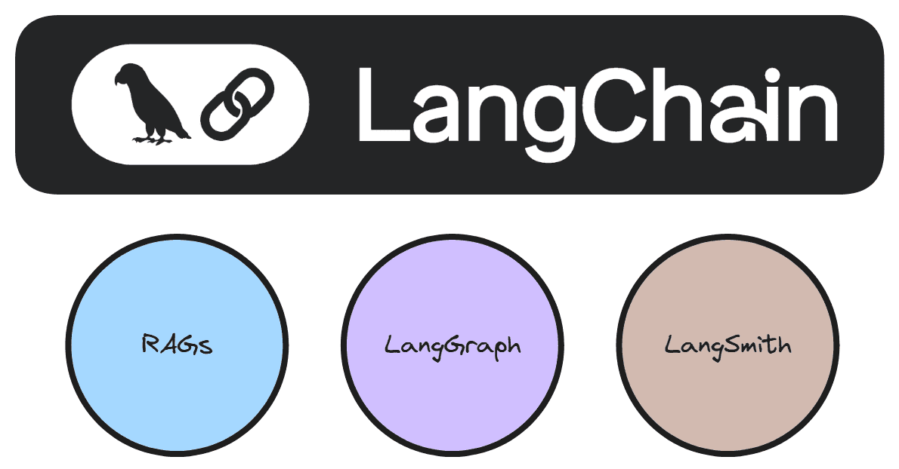

Popular Agentic AI frameworks
Focus of this course
Notes:
CrewAI is a Python framework for building multi-agent LLM systems

Slide 4
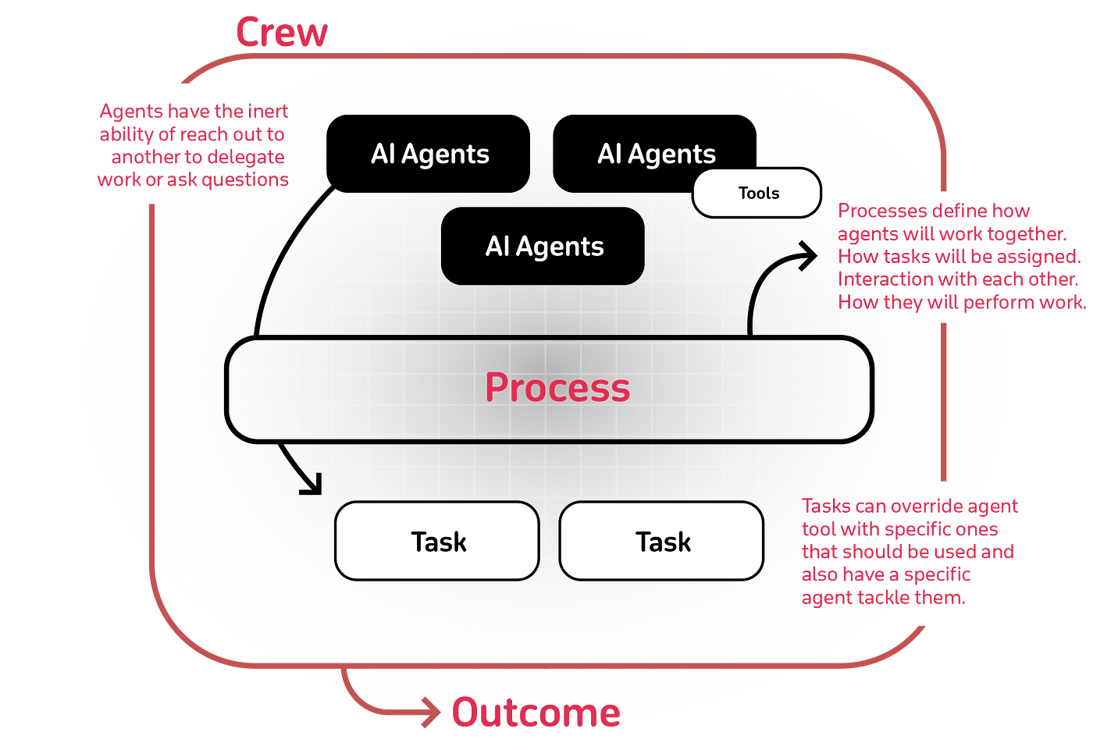
CrewAI: Crew, Agent, Task, Tools, Process
Notes:
Agent – an LLM with a role/goal/backstory and optional tools + constraints (e.g., “Researcher”, “Analyst”, “Writer”).
Task – a concrete piece of work assigned to an agent (with a clear description and expected output).
Crew – the group of agents + the set of tasks + the process (sequential, parallel, or hierarchical with a manager).
Tools – functions/APIs the agent can call (RAG retriever, web search, calculator, DB, code runner, file I/O…).
Process – how work flows: hand-offs, ordering, manager/critic loops, etc. (=Planning)
CrewAI is a Python framework for building multi-agent LLM systems: you define several specialized agents (roles), give them tasks, optionally wire in tools (RAG, web/APIs, code, files), and CrewAI coordinates their collaboration or process (hand-offs, sequencing, debate/critique) to produce a final result.

Slide 5

https://docs.crewai.com/

Slide 6
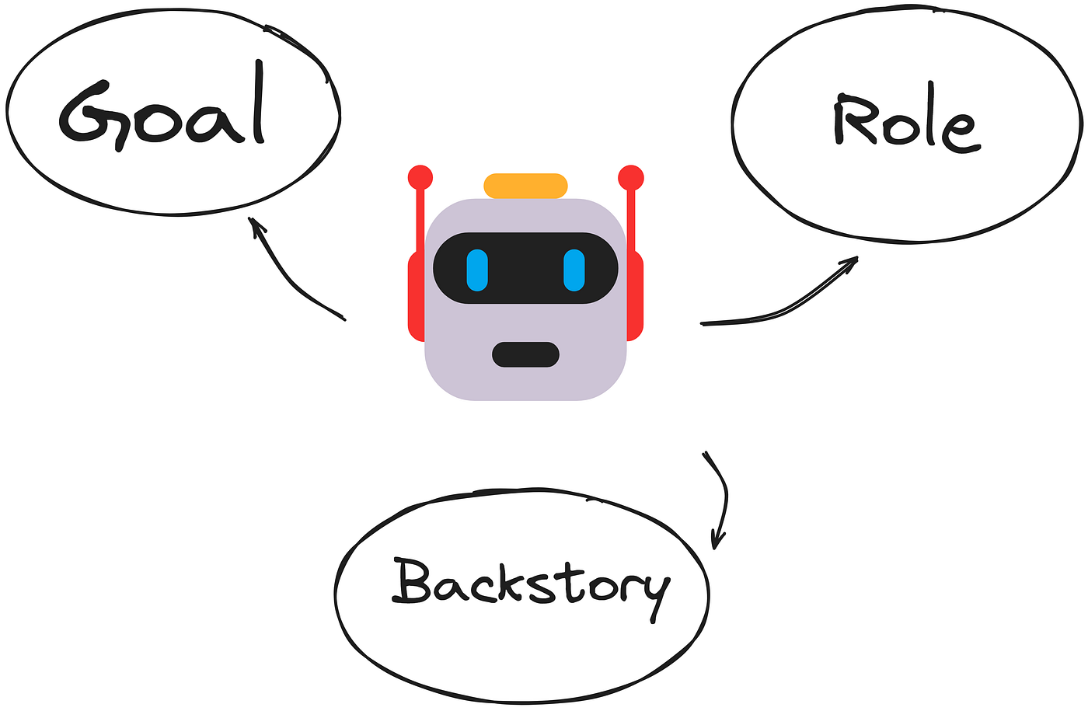
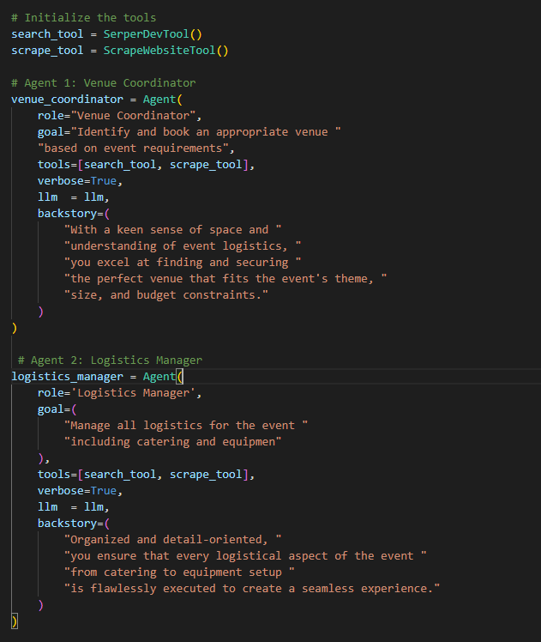
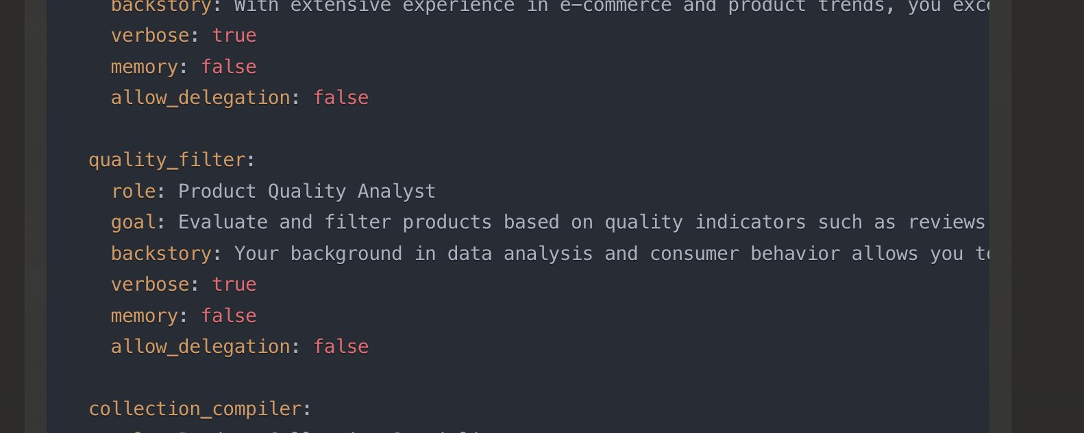
CrewAI: Agent
‘Old way’: agents.py file
‘New way’: /config/agents.yaml
Notes:
Create agents
Role, goal, backstory
Verbose, memory, allow_delegation

Slide 7
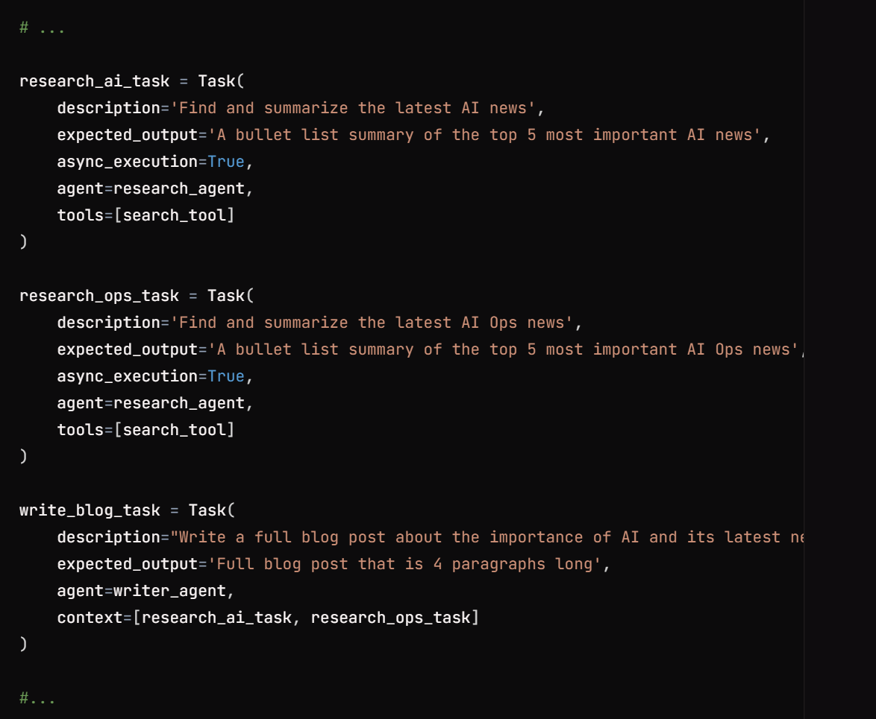
CrewAI: Task
Define Tasks
In tasks.py
Or, in config/tasks.yaml
Notes:
Define tasks

Slide 8
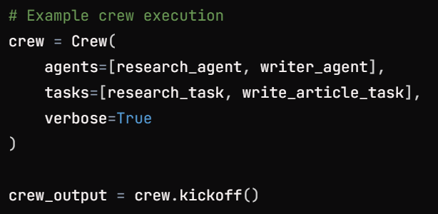
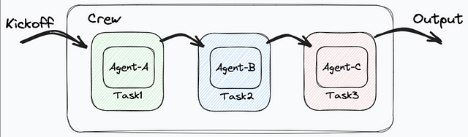
CrewAI: Crew
Default process: sequential
Notes:
Create the crew (agents, tasks, process) and run

Slide 9
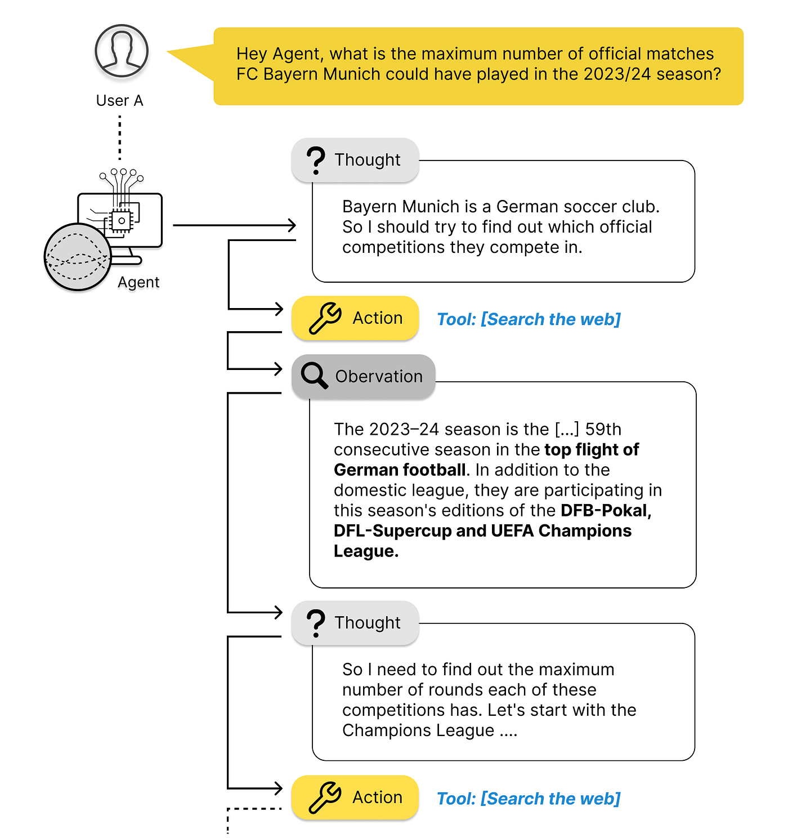
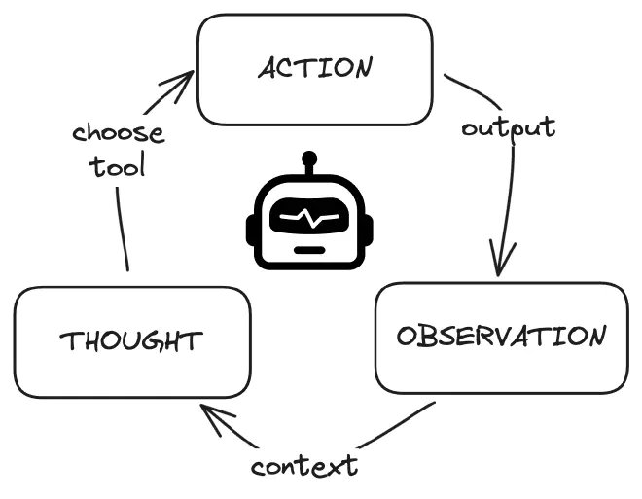
CrewAI Agent: Chain-of-Thought & ReAct (Reasoning & Acting)
Notes:
https://towardsdatascience.com/navigating-the-world-of-llm-agents-a-beginners-guide-3b8d499db7a9
Chain-of-Thought (CoT)
The agent reasons step by step in natural language before deciding what to do.
ReAct (Reasoning + Acting)
The agent alternates between reasoning (“thinking”) and acting (“using tools or taking steps”).
CrewAI agents combine Chain-of-Thought (think before you act) with ReAct (reason while acting), enabling intelligent, goal-directed behavior.

Slide 10
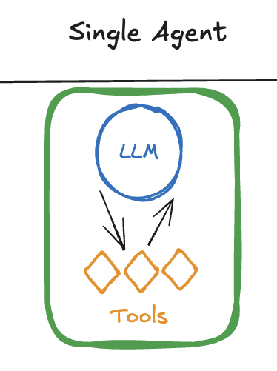

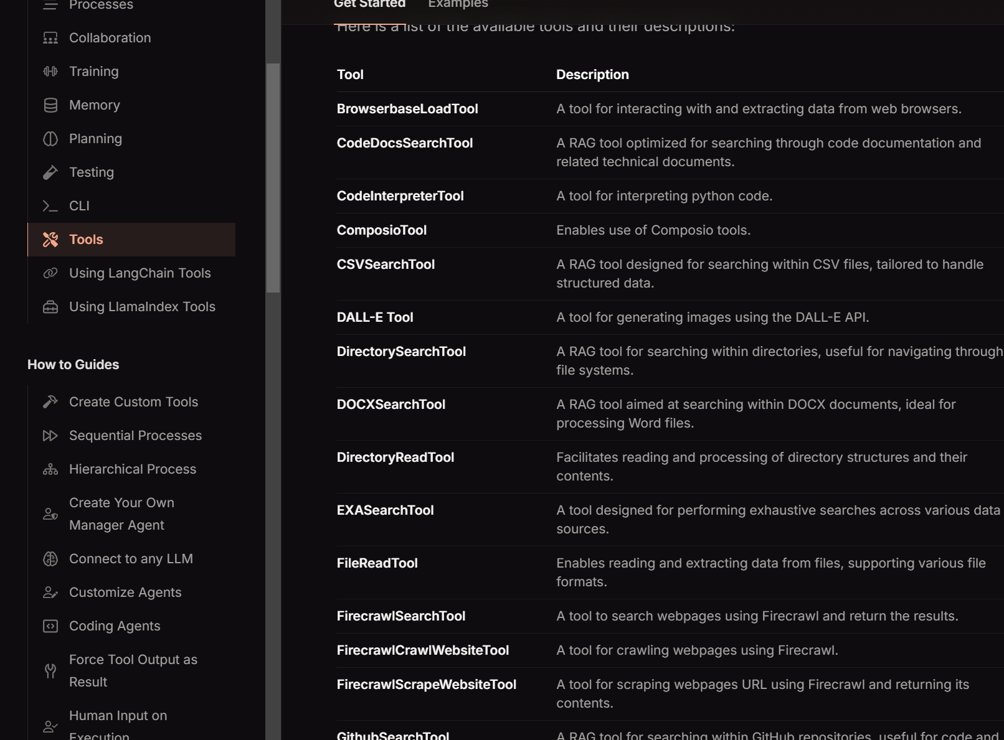
CrewAI: Tools & Integrations
Commonly used tools:
Web search (Serper API), Groq API, YouTube and Media Connectors, Database connectors (SQLAlchemy, PyMongo), Langchain tools, AI Powered tools (DallE API), SeleniumWeb Scraping, LLamaIndex, Slack API, etc.

Slide 11
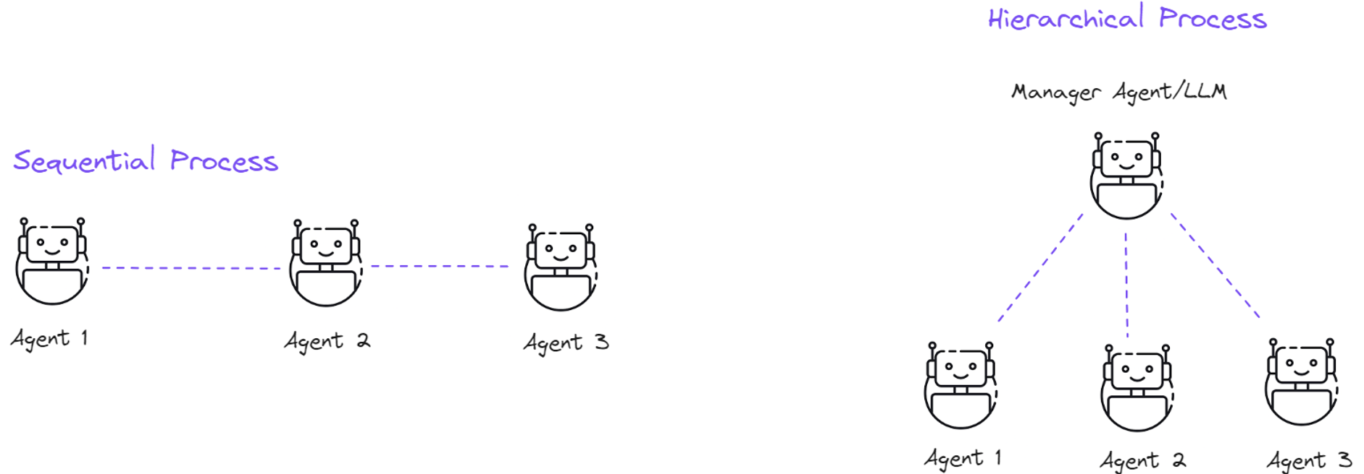
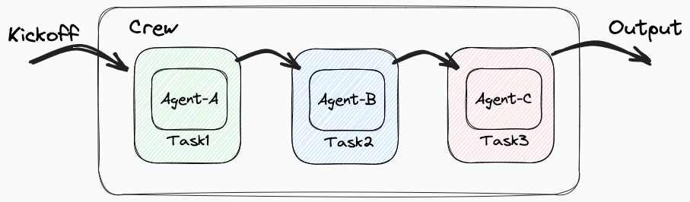
CrewAI: Process/Planning
Notes:
Two main Process types
Linear workflow vs Complex workflow where roles and planning evolve

Slide 12
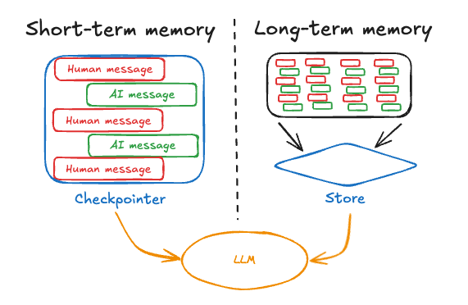
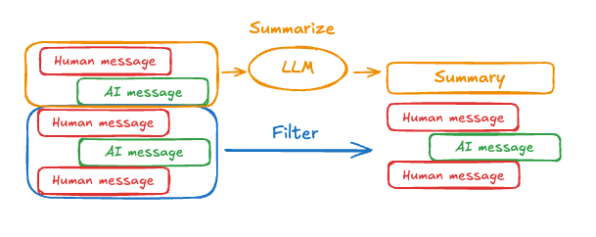
CrewAI: Memory (Short- & Long-term)
Notes:
https://langchain-ai.github.io/langgraph/concepts/#langgraph
Short-term memory stores context within the current process or conversation
Long-term memory persists across runs or sessions
This memory is often stored as embeddings in a vector database, allowing semantic retrieval of relevant information when needed.
Together, short- and long-term memory give agents a sense of continuity, learning, and self-improvement over time.

Slide 13
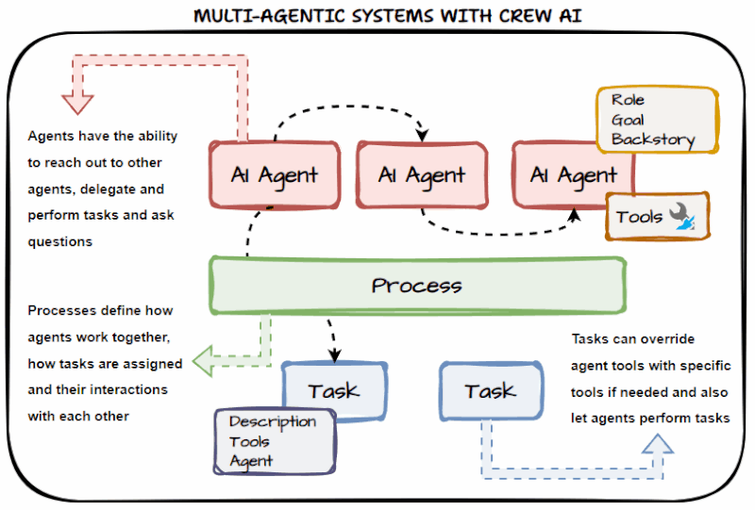
CrewAI: Putting it all together

Slide 14

Deep Learning
Natural Language Processing (NLP)
Word Embeddings – Language Models – RNN – LSTM

Slide 15

Lesson Goals
NLP Preprocessing Pipeline: Students will understand the fundamental preprocessing steps in NLP, including tokenization, token normalization, and vectorization (frequency-based and embedding-based).
Word Embeddings: Students will examine how distributed representations capture word meaning based on the distributional hypothesis, explain how models like Word2Vec learn such embeddings, and recognize the limitations of static, context-independent representations.
RNNs: Students can explain the need for, and the use of, Recurrent Neural Networks (RNNs), They will understand how RNNs process sequential data by maintaining hidden states over time, explain how this enables modeling of temporal and linguistic dependencies, and identify key challenges such as vanishing gradients and limited context memory.
LSTMs: Students will explore how Long Short-Term Memory networks extend RNNs with gating mechanisms that manage information flow, understand how the cell state preserves long-term dependencies, and recognize how this architecture addresses the memory and gradient issues in standard RNNs.

Slide 16
Why NLP? History, challenges and ethics

Slide 17
Why do we need NLP?
Language is the most natural and powerful way for humans to communicate, reason, and share knowledge
Without NLP, computers remain blind to the vast majority of human knowledge expressed through words
NLP aims to achieve both language understanding (comprehending meaning and intent) and language generation (producing coherent, context-aware responses)
NLP allows for:
Efficient access to knowledge
Automation of repetitive language tasks
Enhanced human–machine interaction
Notes:
Language is the most natural and powerful way for humans to communicate, reason, and share knowledge.
Without NLP, computers remain blind to the vast majority of human knowledge expressed through words.
In a world where vast amounts of information are stored as text — from books and websites to social media and medical records — understanding language computationally allows machines to unlock this knowledge.
In the age of big data and AI, NLP has become a cornerstone technology for intelligent systems.
NLP bridges the gap between human communication and machine understanding. It allows for:
Efficient access to knowledge (e.g., search engines, question answering).
Improved accessibility (e.g., speech recognition, translation tools).
Automation of repetitive language tasks (e.g., summarizing reports, analyzing feedback, machine translation, chatbots, information retrieval, summarization, and sentiment analysis).
Enhanced human–machine interaction, where users can communicate with systems in natural language rather than rigid commands.
Natural Language Processing (NLP) enables applications such as machine translation, chatbots, information retrieval, summarization, and sentiment analysis, all of which rely on computers interpreting and generating human language.

Slide 18
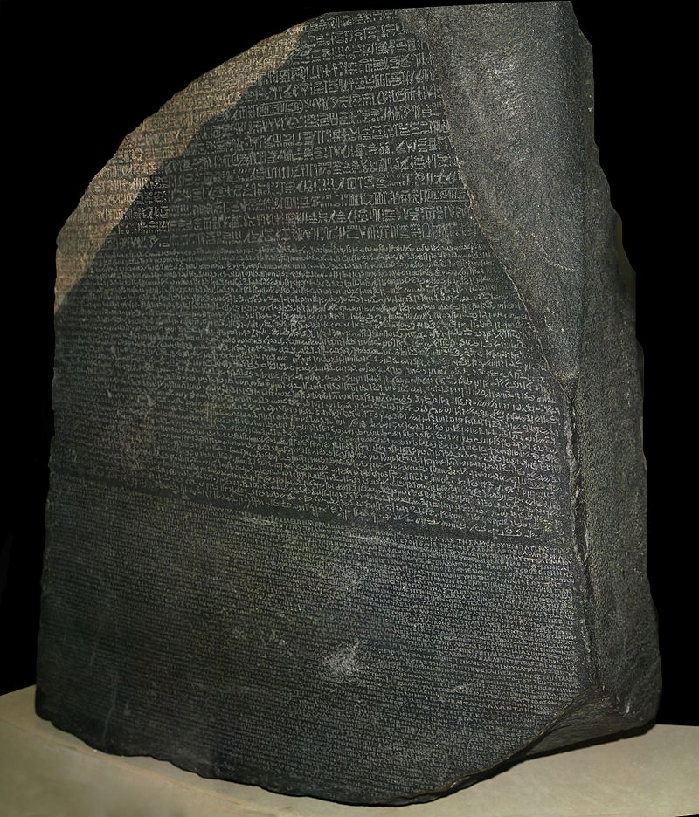

The power of language
Notes:
https://en.wikipedia.org/wiki/Library_of_Alexandria
https://en.wikipedia.org/wiki/Rosetta_Stone

Slide 19
Knowing a language means being able to produce an infinite number of sentences never spoken before and to understand sentences never heard before.
Noam Chomsky

Slide 20
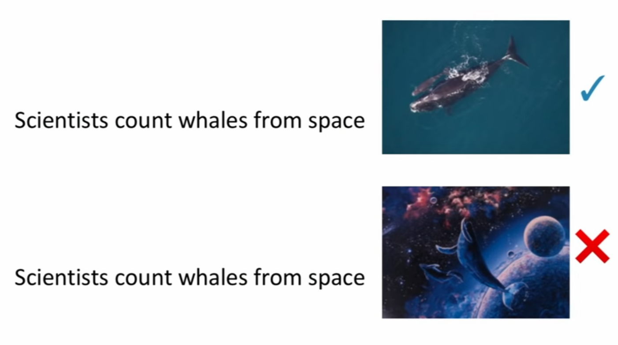
Language is hard
Language is remarkably complex, ambiguous and no two languages express meaning in exactly the same way
Ambiguity
Context dependence
Notes:
Why Language is Hard for Machines
Language is remarkably complex, flexible, and ambiguous — and no two languages express meaning in exactly the same way. For computers, understanding human language means dealing not only with words and grammar, but also with context, variation, and cultural nuance.
Main Challenges:
Ambiguity: Many words and sentences can have multiple meanings. Example: “I saw the man with the telescope.” — Who has the telescope? Resolving this ambiguity requires contextual and sometimes world knowledge.
Context dependence: Meaning often depends on what came before or after a sentence, or on shared background knowledge. Example: “That was cold.” — Praise for a clever remark or a complaint about temperature?

Slide 21
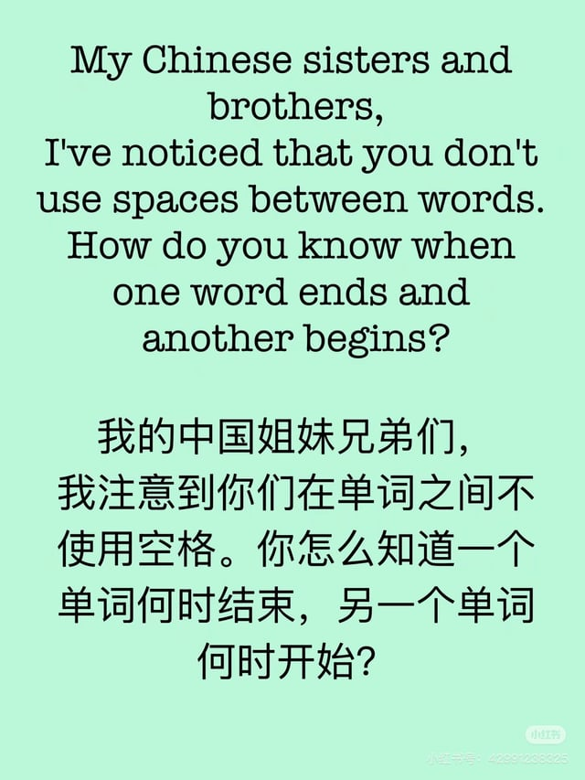

Language is hard
Structural variation
Morphological richness
Tokenization differences
Multilingual complexity
Notes:
Structural variation: Languages differ widely in grammar and word order.
English tends to follow Subject–Verb–Object order (“The cat eats fish”).
Japanese uses Subject–Object–Verb (“The cat fish eats”).
Other languages, like Latin or Finnish, rely more on word endings (inflections) than on order. This diversity makes universal modeling difficult.
Morphological richness: Some languages (like English) have relatively simple word forms, while others (like Turkish, Finnish, or Arabic) express much of their meaning through prefixes, suffixes, and infixes. One root word can generate hundreds of forms, which explodes vocabulary size and makes pattern learning harder.
Tokenization differences: In English, words are typically separated by spaces — making tokenization straightforward. But many languages (e.g., Chinese, Japanese, Thai) lack explicit word boundaries, so tokenization requires learning where one word ends and another begins. This step is fundamental, as incorrect tokenization can propagate errors throughout an NLP pipeline.
Multilingual complexity: Building NLP systems that handle multiple languages adds another layer of difficulty:
Some languages are underrepresented in training data (“low-resource languages”).
Meanings and idioms are often not directly translatable.
Cross-lingual models must learn to represent shared meaning across very different linguistic systems.
Cultural and pragmatic nuances: Language reflects culture, tone, and social norms — elements that are difficult to capture statistically. Irony, politeness, or sarcasm can invert meaning, posing major challenges for machine understanding.
Summary:
Human language is not a single system but a vast, evolving collection of diverse, ambiguous, and context-dependent communication forms. This makes NLP both one of the most powerful and one of the most challenging areas in artificial intelligence.

Slide 22
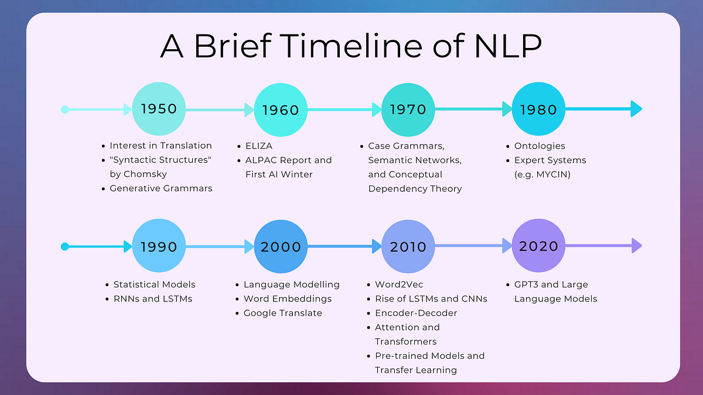
Notes:
https://medium.com/nlplanet/a-brief-timeline-of-nlp-bc45b640f07d
The field of NLP has evolved through several distinct phases:
1950s–1970s: Rule-based systems
Early systems like ELIZA (1966) relied on handcrafted linguistic rules.
Limited flexibility; language knowledge had to be explicitly coded.
1980s–1990s: Statistical NLP
Shift from manually written rules to data-driven approaches using probabilities.
Hidden Markov Models and n-gram models dominated speech and text processing.
2000s: Machine learning-based NLP
Algorithms like SVMs and CRFs allowed better generalization from labeled data.
Features were still manually engineered.
2010s–today: Deep learning and transformers
Introduction of Word2Vec, RNNs, and later transformers like BERT and GPT revolutionized the field.
Models learn contextual language representations directly from data.
The emergence of agentic AI enables using language as an interface for reasoning and acting.
This evolution reflects the broader AI trend: from rules → to statistics → to neural understanding.

Slide 23
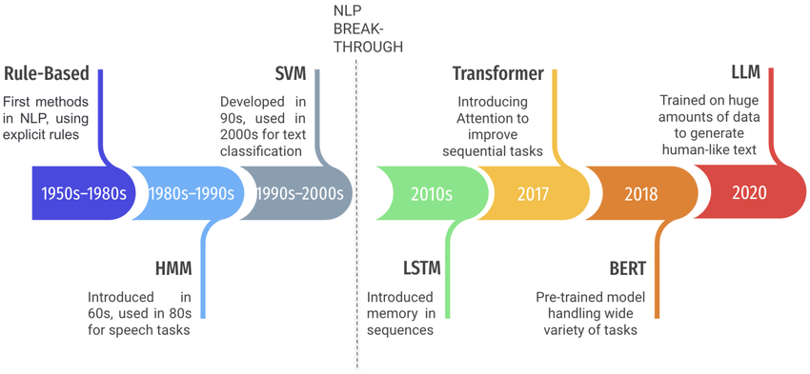
History of NLP
Notes:
researchgate.net/publication/378017549_A_Survey_on_Challenges_and_Advances_in_Natural_Language_Processing_with_a_Focus_on_Legal_Informatics_and_Low-Resource_Languages/figures?lo=1&utm_source=google&utm_medium=organic
The field of NLP has evolved through several distinct phases:
1950s–1970s: Rule-based systems
Early systems like ELIZA (1966) relied on handcrafted linguistic rules.
Limited flexibility; language knowledge had to be explicitly coded.
1980s–1990s: Statistical NLP
Shift from manually written rules to data-driven approaches using probabilities.
Hidden Markov Models and n-gram models dominated speech and text processing.
2000s: Machine learning-based NLP
Algorithms like SVMs and CRFs allowed better generalization from labeled data.
Features were still manually engineered.
2010s–today: Deep learning and transformers
Introduction of Word2Vec, RNNs, and later transformers like BERT and GPT revolutionized the field.
Models learn contextual language representations directly from data.
The emergence of agentic AI enables using language as an interface for reasoning and acting.
This evolution reflects the broader AI trend: from rules → to statistics → to neural understanding.

Slide 24
Ethics and Bias in NLP
As NLP systems are deployed widely, their social and ethical implications have become critical
Ethics in NLP concerns the responsible design, training, and use of NLP systems such as to ensure they benefit society and avoid harm
Bias refers to systematic unfairness in how models treat or represent individuals or groups, often reflecting biases present in training data
Ethics and bias are not just technical issues: they are deeply human concerns
As models grow more capable and more agentic we must ensure they reflect our best human values: fairness, inclusivity, and respect for truth
Ethical awareness should be integrated into every step of the NLP pipeline, from data collection to deployment
Notes:
Ethics in NLP concerns the responsible design, training, and use of language models to ensure they benefit society and avoid harm.
For example:
Gender bias (“doctor” predicted as male, “nurse” as female).
Cultural bias (non-Western names or languages underrepresented).
Toxicity (models generating harmful or offensive content).
Developers, researchers, and users all play a role in ensuring that NLP technologies are used responsibly. Understanding the limitations and potential harms of NLP is just as important as celebrating its capabilities.
NLP has transformed how humans interact with technology, but with this power comes responsibility. As models grow more capable — and more agentic — we must ensure they reflect our best human values: fairness, inclusivity, and respect for truth. Ethical awareness should be integrated into every step of the NLP pipeline, from data collection to deployment.

Slide 25
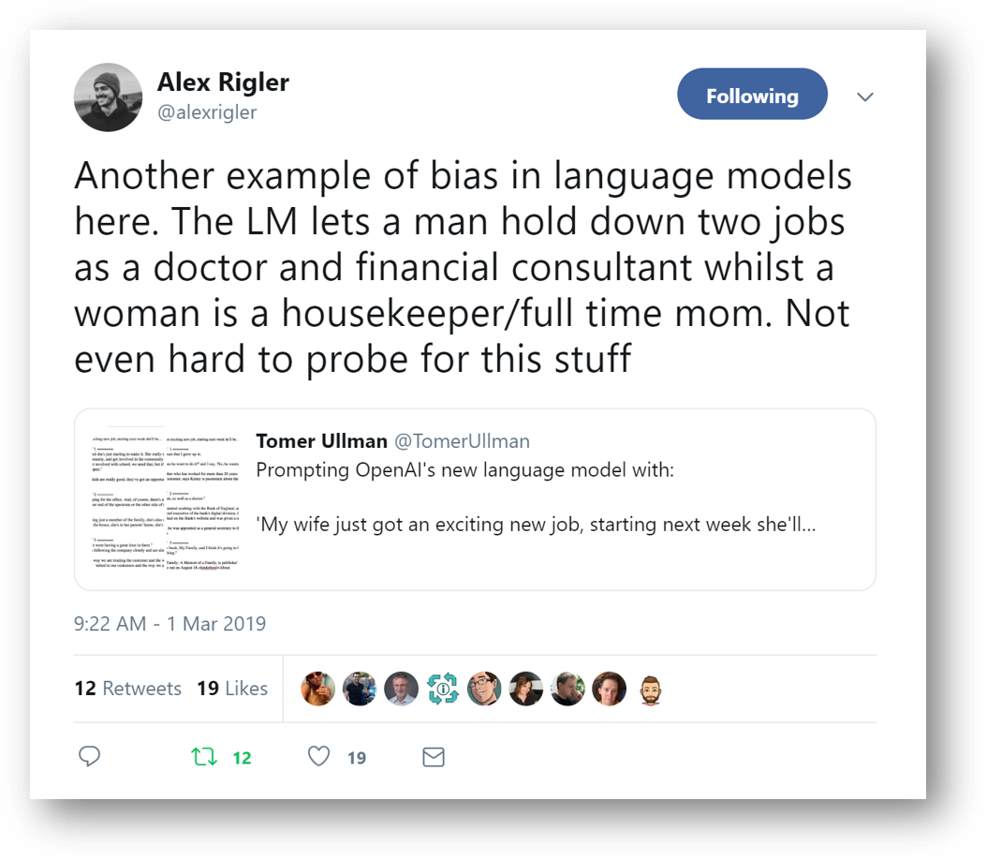
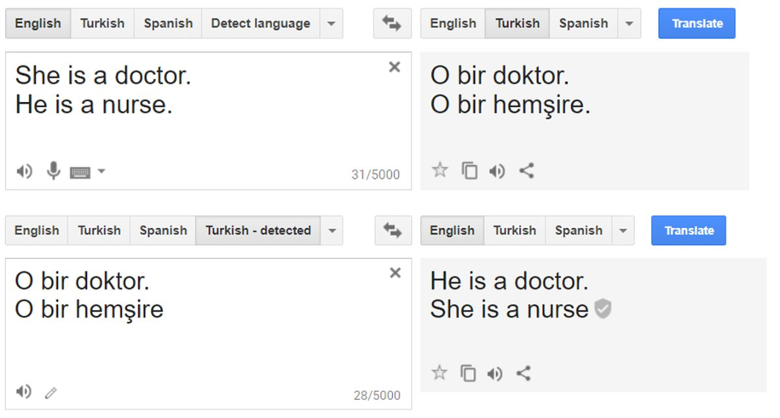
Gender Bias

Slide 26
Sources of Bias
Bias can enter NLP systems through various channels:
Data bias: Imbalanced or unrepresentative training data
Model bias: Architecture or training methods that amplify existing patterns
Label bias: Human annotators’ subjective judgments
Deployment bias: How systems are used and interpreted in real-world settings
Recognizing and mitigating these biases is essential for building fair, inclusive, and trustworthy AI

Slide 27
Reducing Bias
Modern NLP systems attempt to reduce bias through several strategies:
Data diversification: Including more balanced datasets across gender, culture, and language
Debiasing techniques: Adjusting embeddings or model weights to reduce biased associations
Post-processing filters: Detecting and blocking harmful or offensive outputs
Human feedback loops: Using Reinforcement Learning from Human Feedback (RLHF) to align model behavior with ethical norms
However, no approach is perfect and biases can still re-emerge in subtle ways
Notes:
Techniques before, during and after training
Furthermore, even with advanced mitigation techniques, challenges remain:
Bias detection is complex — not all biases are explicit or measurable.
Fairness trade-offs: Reducing one type of bias can unintentionally introduce another.
Transparency: Large models often function as “black boxes,” making it hard to trace biased reasoning.
Accountability: Determining responsibility when a model causes harm is still an open ethical question.
Future NLP research must balance performance with fairness, transparency, and social responsibility.
NLP has transformed how humans interact with technology, but with this power comes responsibility. As models grow more capable — and more agentic — we must ensure they reflect our best human values: fairness, inclusivity, and respect for truth. Ethical awareness should be integrated into every step of the NLP pipeline, from data collection to deployment.

Slide 28
Preprocessing
Tokenization and vectorization

Slide 29
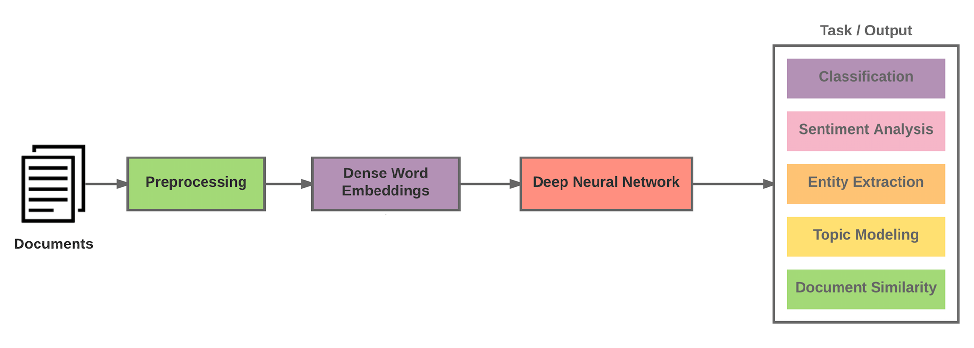
Classical NLP Pipeline
Notes:
The Classical Pipeline In traditional NLP (before around 2018), systems followed a modular, task-specific pipeline:
Documents / Text input
Preprocessing: tokenization, stopword removal, stemming/lemmatization, parsing.
Feature extraction: e.g. Bag-of-Words, TF-IDF, or static embeddings (Word2Vec, GloVe).
Modeling: task-specific neural network or classifier (e.g. CNN, LSTM, SVM).
Downstream task: sentiment analysis, named entity recognition, etc.
Each component had to be manually designed and trained for every task.

Slide 30
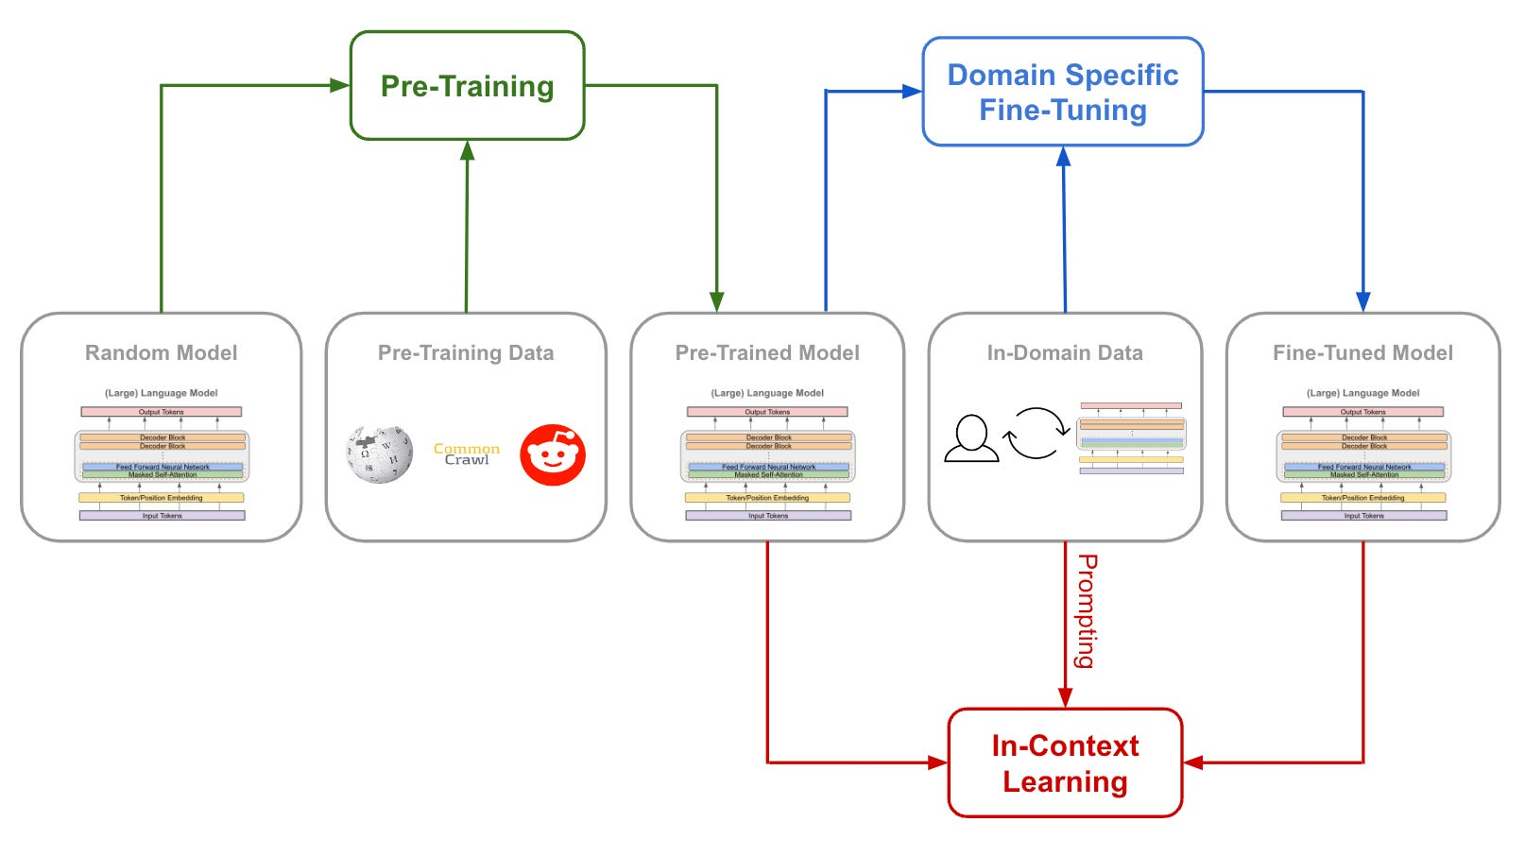
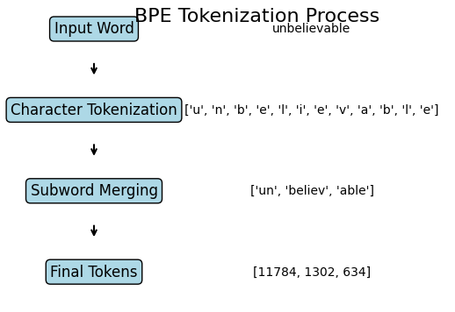
Modern NLP Pipeline Transformer-based Era
Notes:
https://cameronrwolfe.substack.com/p/data-is-the-foundation-of-language
The Modern NLP Pipeline (Transformer-based Era)
Today, we use pre-trained large language models (LLMs) as the foundation. Instead of building everything from scratch, the model itself encodes linguistic knowledge learned from massive text corpora.
Text Input: Raw text is provided, often with minimal preprocessing (lowercasing and punctuation removal are no longer required).
Tokenization: Text is broken into subword tokens using algorithms like Byte-Pair Encoding (BPE) or SentencePiece — designed to handle multilingual vocabularies efficiently.
Pre-trained Language Model: A transformer-based model (e.g., BERT, GPT, T5) converts tokens into contextual embeddings. These embeddings already encode a deep understanding of language structure and meaning.
Fine-tuning or Prompting:
Fine-tuning: The model is further trained on a specific downstream task (e.g., sentiment classification).
Prompting / In-context learning: Instead of retraining, you steer the model using examples or instructions in natural language (as done with GPT-style LLMs).
Task Output: The model generates text, classifies input, or answers a question — often directly, without additional layers or task-specific architectures.
The modern NLP pipeline is centered on pre-trained transformer models that encode linguistic knowledge in their parameters. We no longer build separate pipelines per task — instead, we adapt or prompt a single powerful model to perform many tasks.

Slide 31
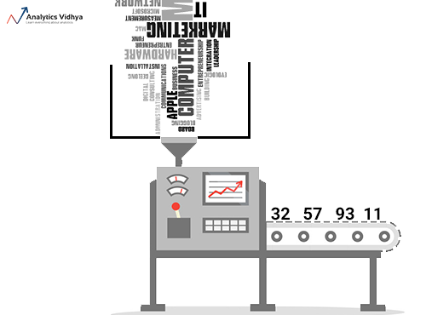
NLP Preprocessing steps
Preprocessing start
Gather (training) documents into a collection = corpus
Process all documents into tokens
Order all tokens by frequency = dictionary
Select x most frequent tokens = vocab (of size x)
Encode / vectorize / numericalize all documents into usable tensors
Preprocessing done

Slide 32

NLP Preprocessing steps
… student
spend
entire night
code
…
... code: 25
…
spend: 13
… entire: 9
…
night: 2
student: 2
…
code
spend
entire
… code: 25
…
spend: 13
… entire: 9
…
…
.06
.05.58
.03
.12
.01
.02
…
… .04
.07
.12
.26
.51
.10
.05
…
… .81
.02
.01
.07
.05
.01
.02
…
the students spend their entire night coding!
Corpus
Tokens
Dictionary
Vocab(ulary)
Tensors
Stemming
Lemmatization
Stop word removal
Count tokens and order
Keep V most frequent V can be huge!
Represent every word, or entire document, as a vector
Step1 Tokenize
Step2 Vectorize

Slide 33
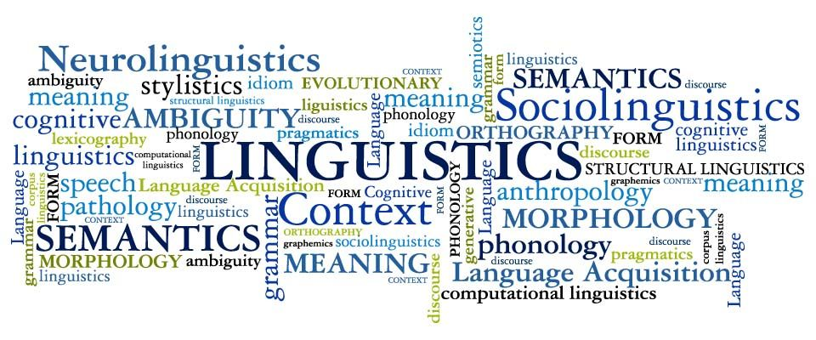



Tokenization Splitting text into meaningful chunks
Many ways to ‘Tokenize’ + language dependent: split by whitespace, by chars, by regex, … ?
→ Libraries (created with linguistical experts) to the rescue!

Slide 34
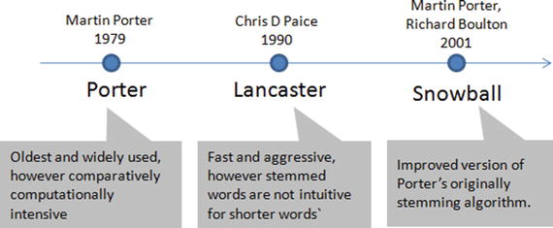
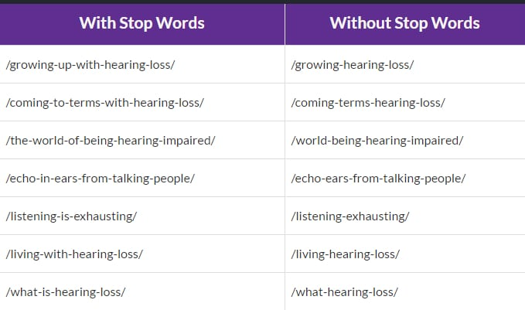
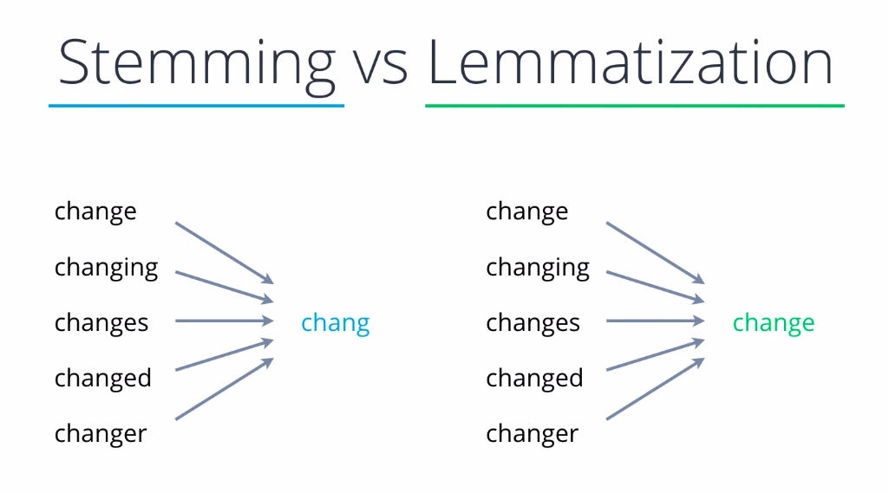
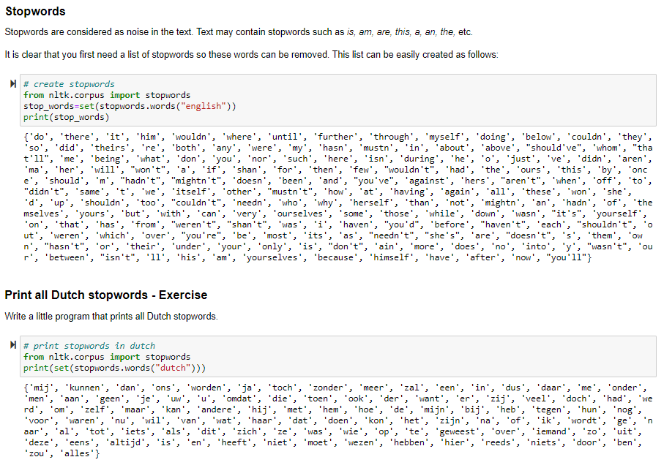
Tokenization Token Normalization
Stemming, Lemmatization, Stop Word removal, etc.
Notes:
These are classic (old school) text preprocessing techniques in Natural Language Processing
Stemming
Reduce words to their root form by chopping off endings (suffixes/prefixes).
Uses simple heuristic rules (not linguistic knowledge).
The result isn’t always a valid word (“chang”), but it helps models treat word variants as equivalent.
Lemmatization
Reduce words to their dictionary base form (lemma) — the linguistically correct root.
Uses vocabulary and grammar rules (part-of-speech tagging, morphology).
Produces actual words and preserves meaning better than stemming, but is slower.
Stop word removal
Remove very common words that carry little semantic content in many tasks.
These words appear frequently and rarely help with classification, topic modeling, or search relevance.
Note: The choice of stop words depends on the task — for translation or sentiment analysis, you may want to keep them.

Slide 35

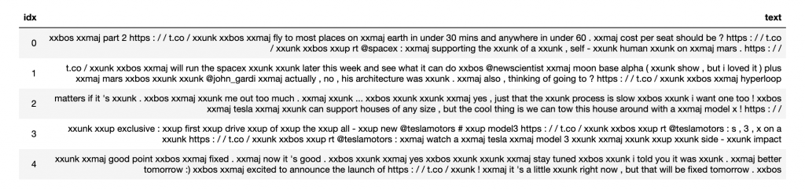
Tokenization Adding custom or special tokens / meta data
Fastai uses spaCy by default (can use other tokenizers as well) – ‘TextDataLoaders’
Adds some custom optimization/normalization ‘chunks’
By normalizing tokens, some information is lost. These chunks add that information back to the data
xxbos: beginning of sentence
xxmaj: capitalize first letter of next word
xxunk: unkown token, or falls outside of the limits of the vocab
…

Slide 36

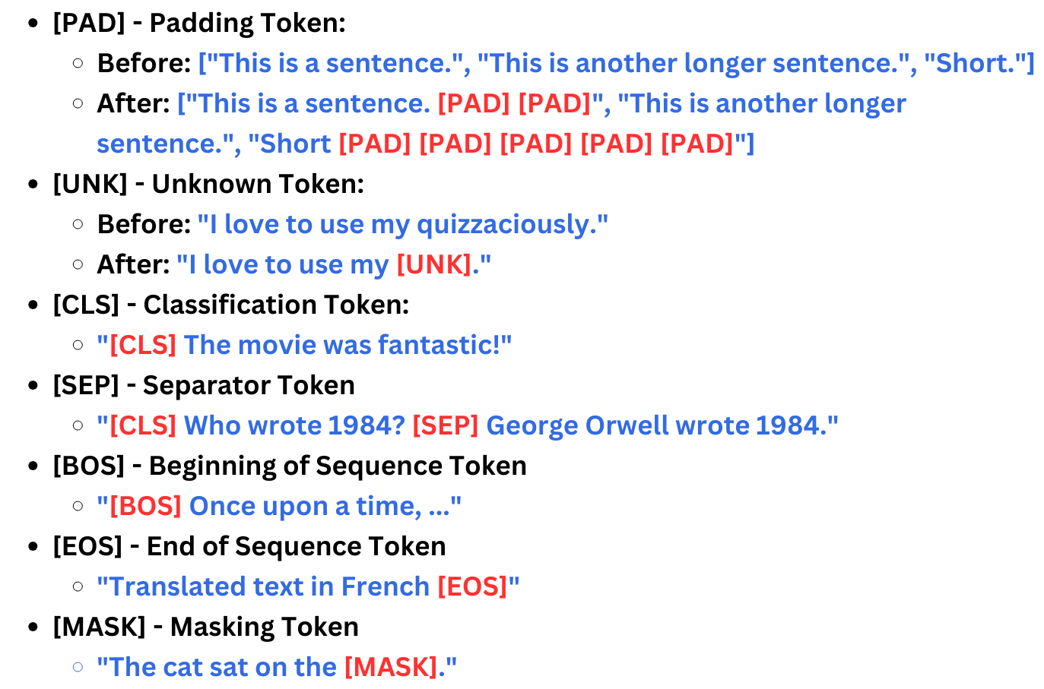
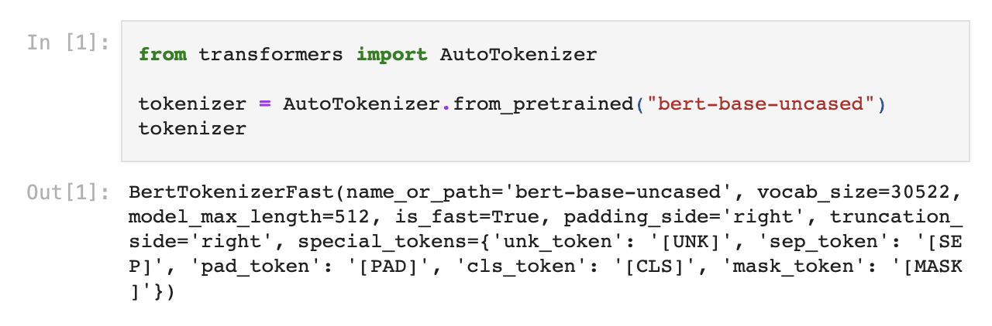
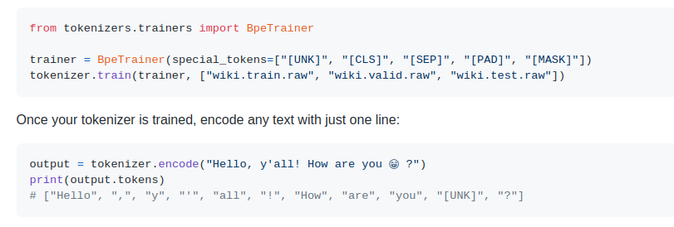
Tokenization Special tokens

Slide 37
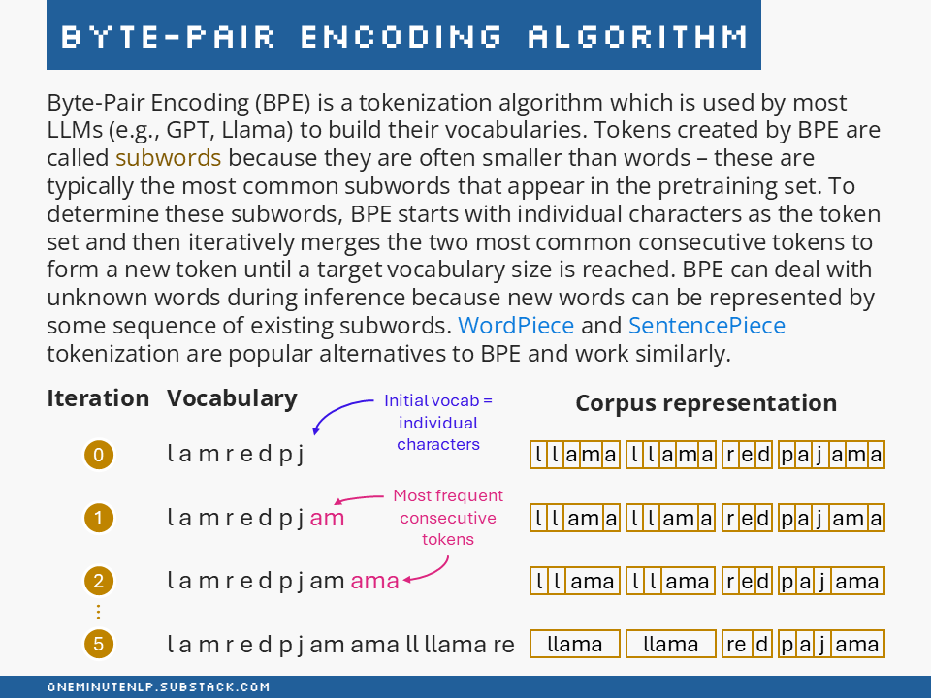
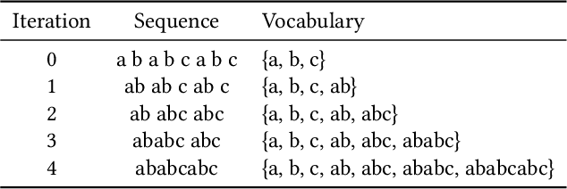
Out of Scope Byte-Pair Encoding
Notes:
In the modern NLP pipeline, text is broken into subword tokens using algorithms like Byte-Pair Encoding (BPE) or SentencePiece designed to handle multilingual vocabularies efficiently.

Slide 38
NLP Preprocessing steps
… student
spend
entire night
code
…
... code: 25
…
spend: 13
… entire: 9
…
night: 2
student: 2
…
code
spend
entire
… code: 25
…
spend: 13
… entire: 9
…
…
.06
.05.58
.03
.12
.01
.02
…
… .04
.07
.12
.26
.51
.10
.05
…
… .81
.02
.01
.07
.05
.01
.02
…
the students spend their entire night coding!
Corpus
Tokens
Dictionary
Vocab(ulary)
Tensors
Stemming
Lemmatization
Stop word removal
Count tokens and order
Keep V most frequent V can be huge!
Represent every word, or entire document, as a vector
Step1 Tokenize
Step2 Vectorize

Slide 39
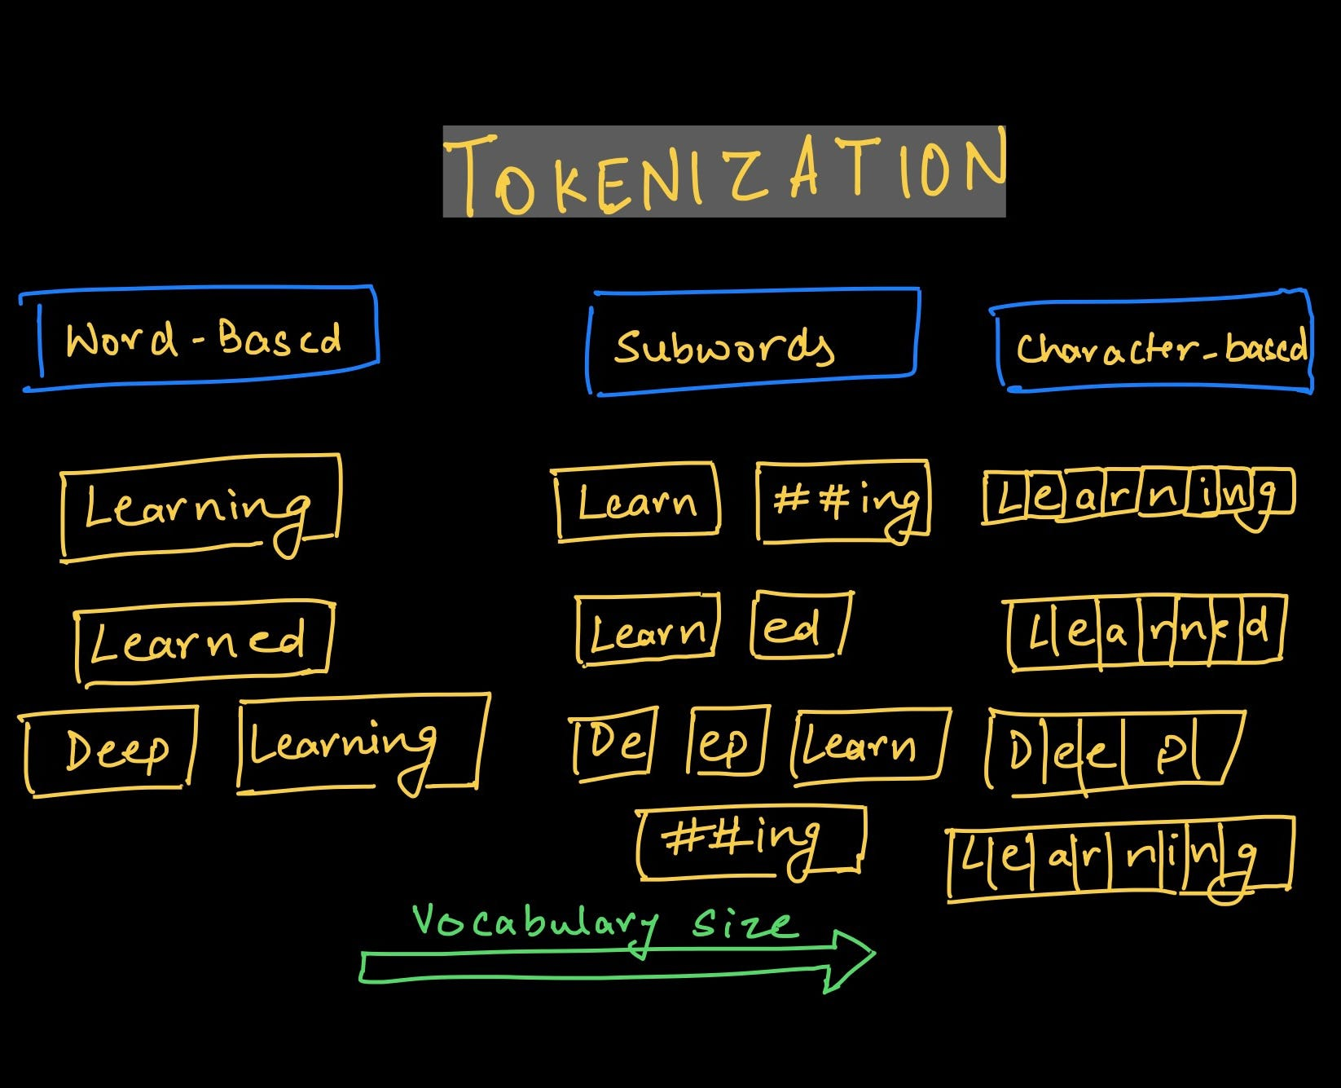

Preprocessing Goal: Turning text into usable tensors
What is a ‘usable tensor’? It all depends on the use case!
The level of granularity at which you vectorize can vary:
Character-level
Subword-level (most common)
Byte-Pair Encoding (BPE)
Word-level
Sentence-level
Document-level
Notes:
https://gdcoder.com/all-you-need-to-know-about-nlp-text-preprocessing/ Give examples of different uses cases that require different levels

Slide 40
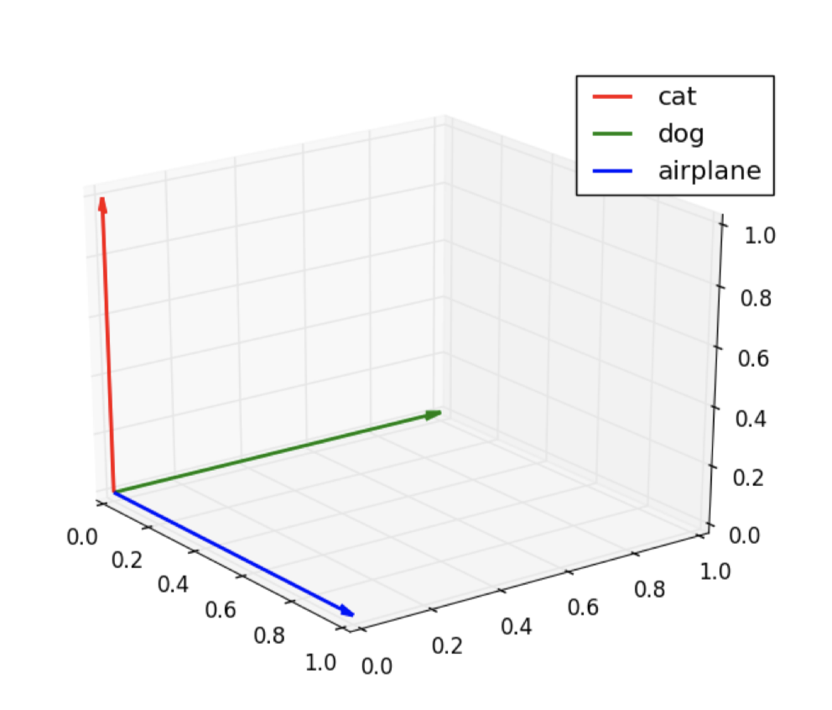
One-hot encoding Word embedding
In one-hot encoding (1-of-N encoding) each word is represented as a vector of N (= size of vocabulary) components with one component activated and the others zero E.g., vocabulary = (airplane, dog, cat) airplane = [1 0 0] dog = [0 1 0] cat = [0 0 1]
Provides vectors that are sparse (mostly zeros) and high-dimensional (one dimension per vocabulary term)
Each dimension has an explicit semantic
There is no notion of similarity between words
Notes:
+simple way to encode words
+interpretable
-no notion of similarity, every word is very distinct, not reflected that two words (dog, cat) are more similar
-no context information is used
There is no context info, no ‘spatial relationship’ between the tokens, no similarity measurement: cosine similarity of cat and dog is 0

Slide 41
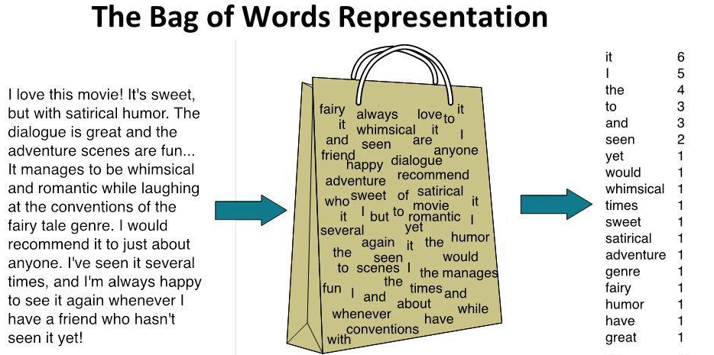
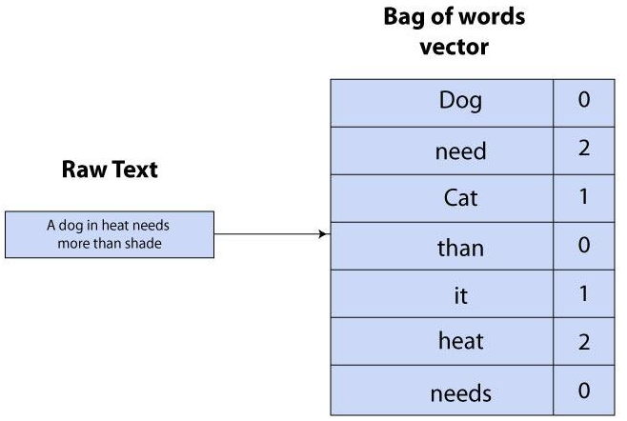
Bag-of-Words (BoW) Sentence or document embedding
BoW creates a vector for each document, one-hot encoding style
Entire document is vectorized (as opposed to vectorizing each token and combining them)
Frequency-based: simple “counting” to represent importance of a token in a document
Notes:
This is a document encoding: trying to add ‘context’ information (freq of tokens) in the encoding of the document.

Slide 42
TF-IDF Sentence or document embedding
Another frequency-based document representation method:
Term Frequency (TF) = how often a word appears in a document → Common words in a document get higher scores
Inverse Document Frequency (IDF) = how rare the word is across all documents in the corpus → Words that appear in many documents get lower scores
Each document is represented as a vector of TF-IDF values: one value per word (term) in the vocabulary → Produces sparse and high-dimensional vectors
Notes:
Again, a document encoding, adding more ‘contextual’ information to the encoding
It is a numerical representation of text that reflects how important a word is to a document within a collection (corpus).

Slide 43
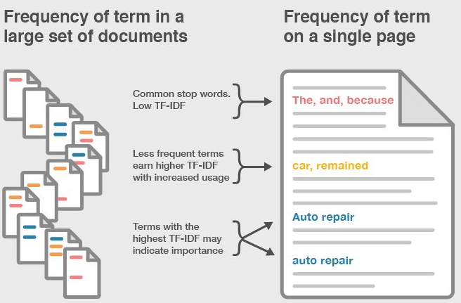
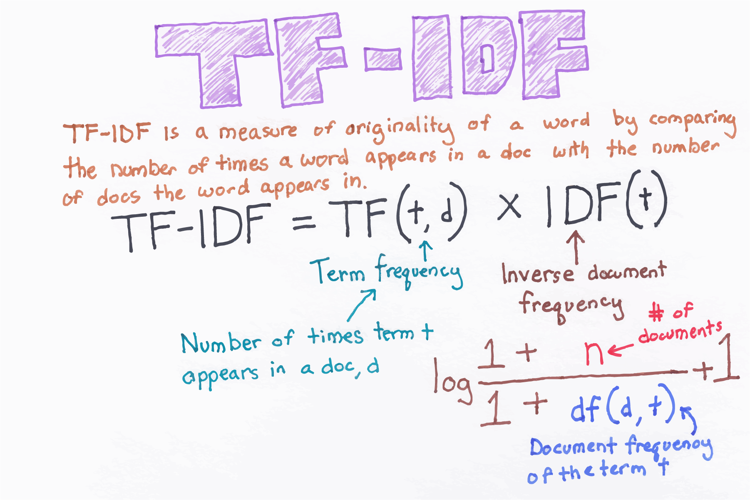
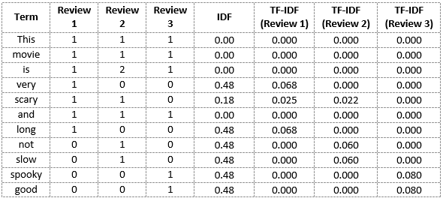
TF-IDF Sentence or document embedding
Review 1: This movie is very scary and long
Review 2: This movie is not scary and is slow
Review 3: This movie is spooky and good
Notes:
https://gdcoder.com/nlp-transforming-tokens-into-features-tf-id
https://www.analyticsvidhya.com/blog/2020/02/quick-introduction-bag-of-words-bow-tf-idf/f/

Slide 44
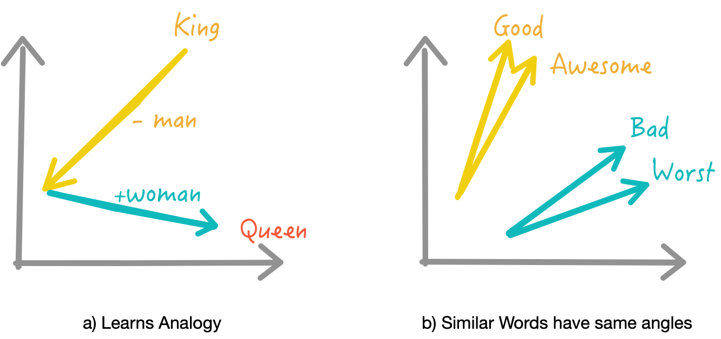
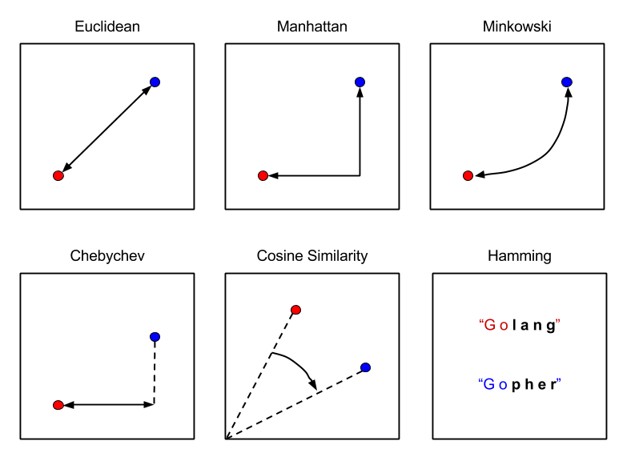
What we want: word similarity in semantic vector space
Notes:
We want to represent words as numerical vectors in such a way that:
Words with similar meanings end up close together,
Words with different meanings are far apart.
This allows a computer to reason about language mathematically — e.g.,
vector(“king”) – vector(“man”) + vector(“woman”) ≈ vector(“queen”)
To achieve this, the model must somehow learn what words mean and meaning in language comes from context.
Cosine similarity is useful in embedding spaces because it measures the angle between vectors, not their absolute length.
This matters because:
Word embeddings encode meaning mostly in their direction, not magnitude.
Two words with similar meanings tend to point in similar directions even if their vectors have different lengths.
Cosine similarity focuses on this directional similarity, making it robust to scale differences and better at capturing semantic relationships.
In short: cosine similarity captures how similar two meanings are by comparing their orientation in the latent space.
direction = which features are present and how they relate.
length = how strongly the features are expressed.

Slide 45
The Importance of Context
The distributional hypothesis

Slide 46


Context is important

Slide 47

Notes:
To obtain a semantic embedding space, the model must somehow learn what words mean and meaning in language comes from context.
This idea comes from linguist J.R. Firth (1957) and is known as the distributional hypothesis. It means that words appearing in similar contexts tend to have similar meanings.

Slide 48
Context to Capture Word Meaning
Computers cannot understand words as we do, they need numbers
Embeddings are how we translate language into numbers in such a way that similar meanings get similar vectors
How can we capture word meaning?
Meaning in language comes from context
Words appearing in similar contexts tend to have similar meanings E.g., “Dog” and “cat” often appear near “pet,” “animal,” “food,” “sleep” “Car” and “truck” appear near “road,” “drive,” “engine”
By observing these patterns, models can learn semantic relationships without explicit supervision

Slide 49


Self-Supervision
Self-Supervised training = automatically getting output label from inputs
Examples:
Word2Vec:
Masked Language modeling (BERT, RoBERTa):
Sentence Permutation (BART):
Emoji Prediction (DeepMoji):
Notes:
https://amitness.com/2020/05/self-supervised-learning-nlp/

Slide 50
Representation Learning
Different architectures operationalize the distributional hypothesis differently to obtain word embeddings in a semantic vector space
Word2vec, RNN, LSTM, BERT, GPT, …
Representation learning aims to find a way to represent words, sentences, or documents in a continuous numerical space so that the geometry reflects meaning
Distances between vectors capture similarity in meaning
Directions encode relationships
Clusters represent topics or semantic fields
Word embeddings emerge naturally during training of language models
Notes:
Relations: king – man + woman ≈ queen

Slide 51
Language models
From word prediction to text generation

Slide 52

Language model
A language model (LM) is a probabilistic model that learns the likelihood of word sequences to predict and generate meaningful text
At its heart, an LM is trained to perform word (or token) prediction
It learns the probability distribution of the next word given a sequence of previous words:
$$P\left(w_{t} \right| w_{1},w_{2}, …,w_{t−1})$$
This is what the model optimizes during training: predicting the next token as accurately as possible
This task teaches the model grammar, syntax, semantics, and world knowledge implicitly which is captured in the model’s internal representations, that is, the word embeddings

Slide 53
Language model
An autoregressive language model performs next word prediction The cat sat on the ___ → mat
A masked language model performs fill-in-the-blank word prediction
The cat ___ on the mat → sat
Text generation happens when the model repeats word prediction iteratively feeding each predicted word back into itself as input The cat sat on the → mat and started to purr softly .
The model generates text by sampling from its predicted probability distribution at each step (optionally controlled by temperature)
Notes:
Instead of predicting just one next word, it predicts a sequence of next words — building sentences, paragraphs, or entire conversations.

Slide 54

Evolution of Language Models
Notes:
https://klu.ai/glossary/large-language-model

Slide 55
Statistical LM
N-gram models

Slide 56
N-gram LM
Predicts a word based on the previous N - 1 words
Unigram (N=1), Bigram (N=2), Trigram (N=3)
Assumes that the next word depends only on a limited history rather than the entire sentence
Probabilities are estimated based on counting, where smoothing is used for unseen sequences
Limited by fixed context, data sparsity and poor generalization
Replaced by neural LMs that learn dense, continuous vectors where a word’s meaning is encoded across many dimensions and that capture long-range dependencies
Notes:
N is a parameter
Unigram: prob of single word, bigram prob of word given previous word, …
Markov assumption: only recent context matters.

Slide 57



Bigram LM
Step 1: Get training text corpus
Step 3: For each word in the vocabulary, count the possible second words
Step 2: Collect all bigrams
Notes:
https://datachild.net/machinelearning/bigram-language-model-python

Slide 58

Bigram LM
Step 4: Use counts to generate text
Notes:
https://datachild.net/machinelearning/bigram-language-model-python
Take a random starting word from this set and pick one of the possible second (following) words. Then repeat, by taking that picked word and finding bigrams where it’s the first word. Then take one of the second words from found bigrams:

Slide 59

N-gram LM
Notes:
https://web.stanford.edu/~jurafsky/slp3/3.pdf

Slide 60
Neural LM
Word2Vec

Slide 61



Word2Vec
The distributional hypothesis says: “words that occur in similar contexts tend to have similar meanings”
Word2Vec operationalizes this insight using shallow neural networks trained on a simple prediction task that forces the model to discover semantic relationships
Predict a word, given the surrounding words: (CBOW)
Predict the surrounding words, given a word: (Skip-gram)

Slide 62

Word2Vec: Context Window
The context window defines how many words around a target word the model considers as its context during training
Notes:
https://cbail.github.io/textasdata/word2vec/rmarkdown/word2vec.html

Slide 63

Word2Vec: CBOW (Continuous BoW)
Prediction task: Predict a word, given the context
Combine the representations of the context words
Guess which word in the vocabulary best fits in the blank
Learning mechanism:
Each word starts with a random vector
Adjusts vectors slightly each time so that the context words, when combined, are closer to the target word vector
Notes:
Input: words in the form of 1-hot word vectors within short window without their position: the vectors are summed
Output: the current word is predicted
The hidden layer implements a linear function: efficient computation
Word2Vec has three layers: input → hidden → output.
The hidden layer is smaller than the vocabulary — acts as a compression or embedding layer.
It forces the model to encode each word’s semantic and syntactic properties in a compact vector.
The weights of this layer after training are the learned word embeddings.

Slide 64
Word2Vec: CBOW (Continuous BoW)
Input layer averages (or sums) one-hot vectors for each context word and passes them to the hidden layer
Hidden layer
Transforms that huge one-hot vector into a dense, continuous representation
Compression or embedding layer
Output layer predicts the target word based on the compressed representation
Notes:
Shallow network with three layers: Input layer → Hidden layer → Output layer
The input layer represents context words as a one-hot vectors — a long vector where only one position is 1 and all others are 0. → This vector has as many dimensions as there are words in the vocabulary (e.g., 50,000). The model averages (or sums) these vectors, then passes them to the hidden layer.
The hidden layer is much smaller (e.g., 100–300 dimensions). It transforms that huge one-hot vector into a dense, continuous representation — the word embedding.
Because this layer forces the network to compress information about each word into a limited number of features,
it acts as a compression layer or embedding layer that captures patterns about how words are used and related.
The output layer then predicts the target word based on this compressed representation
Through training, the weights in the hidden layer are adjusted to make these predictions accurate. These weights become the final word embeddings.

Slide 65

Word2Vec: Skip-gram
Prediction task: Predict the context, given a word
Look at a target word and try to guess the words that usually appear around it
Learning mechanism:
Each word starts with a random vector
Adjusts vectors slightly each time, so that the target word vector is pulled closer to the context word vectors
Notes:
Input: the current word in the form of a 1-hot vector
Output: the words within a short window are predicted, the network predicts the surrounding words, not their position
The hidden layer implements a linear function: efficient computation
Word2Vec has three layers: input → hidden → output.
The hidden layer is smaller than the vocabulary — acts as a compression or embedding layer.
It forces the model to encode each word’s semantic and syntactic properties in a compact vector.
The weights of this layer after training are the learned word embeddings.

Slide 66
Word2Vec: Skip-gram
Input layer represents the current word as a one-hot vector and passes it to the hidden layer
Hidden layer
Transforms that huge one-hot vector into a dense, continuous representation
Compression or embedding layer
Output layer predicts the context words based on the compressed representation
Notes:
Shallow network with three layers: Input layer → Hidden layer → Output layer
The input layer represents the current word as a one-hot vector — a long vector where only one position is 1 and all others are 0. → This vector has as many dimensions as there are words in the vocabulary (e.g., 50,000).
The hidden layer is much smaller (e.g., 100–300 dimensions). It transforms that huge one-hot vector into a dense, continuous representation — the word embedding.
Because this layer forces the network to compress information about each word into a limited number of features,
it acts as a compression layer or embedding layer that captures patterns about how words are used and related.
The output layer then predicts context words based on this compressed representation
Through training, the weights in the hidden layer are adjusted to make these predictions accurate. These weights become the final word embeddings.

Slide 67
Word2Vec: Idea
CBOW and Skip-gram are shallow networks consisting of three layers
The hidden layer is smaller than the vocabulary and acts as a compression or embedding layer
It forces the model to encode each word’s semantic and syntactic properties in a compact vector
Through training, the weights in the hidden layer are adjusted to make the predictions accurate
These weights become the final word embeddings where words that occur in similar contexts (e.g., apple and orange) get similar embeddings
Can be pre-trained on large corpus (transfer learning) and used as a lookup table
Notes:
The network has three layers: Input layer → Hidden layer → Output layer
The input layer represents the current word (or context words) as a one-hot vector — a long vector where only one position is 1 and all others are 0. → This vector has as many dimensions as there are words in the vocabulary (e.g., 50,000).
The hidden layer is much smaller (e.g., 100–300 dimensions). It transforms that huge one-hot vector into a dense, continuous representation — the word embedding.
Because this layer forces the network to compress information about each word into a limited number of features,
it acts as a compression layer or embedding layer that captures patterns about how words are used and related.
The output layer then predicts target word/context words based on this compressed representation
Through training, the weights in the hidden layer are adjusted to make these predictions accurate. These weights become the final word embeddings.
Lookup table: for each word in vocabulary there will be an embedding

Slide 68
Word2Vec
“Predict a word, given the context”
Weights of trained network are compressed representation of word
“Predict the context, given the word”
Words that are contextually closer, will be closer in vector space!

Slide 69

Embedding Projector https://projector.tensorflow.org/

Slide 70




Word2Vec: Geometry reflects meaning
Notes:
Word similarity questions can be answered by simple algebraic operations

Slide 71



Word2Vec: Multiple degrees of similarity
Notes:
Word similarity tasks that evaluates which syntactic and semantic regularities are captured

Slide 72
Dimensionality of Word Embeddings
Too low-dimensional
It cannot capture all the subtle syntactic and semantic relationships between words
Words with distinct meanings might end up too close together
Too high-dimensional
The model may overfit or learn redundant patterns
Computation and memory costs increase sharply
In practice:
Classical word embeddings (e.g., Word2Vec, GloVe) often used 100–300 dimensions
Modern LLMs (e.g., GPT, BERT) use hundreds to thousands of dimensions (e.g., 768, 1024, or more)
Notes:
Too low-dimensional: the model lacks expressive power
Too high-dimensional: inefficient and potentially harmful
but these are tied to the model’s internal architecture, not chosen arbitrarily

Slide 73
Word2Vec: Not Technically an LM
Word2Vec is not a full language model, but a representation learning model for words trained using a simplified prediction task
Predicts context words, not the next word in order
Learns embeddings, not sequence probabilities
Has no concept of sentence order or syntax beyond a small window of context
However, its learned space of word relationships makes it useful for lightweight language modeling tasks, information retrieval, and many downstream NLP tasks

Slide 74

Word2Vec: A Static Embedding Model
Every word in the vocabulary has one fixed vector, no matter where or how it is used
Word2Vec captures average meaning of the word across all contexts, but not the specific sense in any given sentence
Cannot handle multiple meanings
Notes:
Cannot Handle Polysemy (Multiple Meanings)
Words with multiple meanings (e.g., bank, apple, charge, light) are represented by a single vector.
The model can’t tell which meaning is intended in a given sentence.
This hurts performance in tasks requiring fine-grained understanding (e.g., word sense disambiguation, translation, reasoning).
Example: “bass” (the fish) vs. “bass” (the instrument) → same embedding, confusing for the model.
Ignores Contextual Variation
The embedding for a word doesn’t change based on nearby words.
So, subtle differences in tone, syntax, or semantics (e.g., negation, emphasis, irony) are lost.
Example: “good” in “not good” still looks positive because context is ignored.
Weak for Compositional Meaning
Since each word is independent, Word2Vec struggles to represent phrases, sentences, or paragraphs accurately.
The only option is to average word vectors — which loses ordering and interaction between words.
Example: “The dog chased the cat” vs. “The cat chased the dog” → same average vector!
Limited for Downstream Tasks
Tasks like question answering, machine translation, and dialogue rely heavily on context.
Static embeddings don’t adapt dynamically, so modern systems need contextual embeddings (like those from BERT or GPT) that change with each usage.

Slide 75
Pre-trained LM
RNN and LSTM

Slide 76
From Word2Vec to RNN
Word2Vec learns meaningful word embeddings that capture semantic similarity, but …
Each word has one static embedding
There is no sense of word order or sentence structure
To model language as a sequence, we need architectures that:
Process words in order
Remember what came before
Update their understanding at each step
This is where Recurrent Neural Networks (RNNs) come in, which add memory to neural language models
Notes:
Word2Vec learns meaningful word embeddings (distributed representations) that capture semantic similarity (“king” ≈ “queen – man + woman”).
but each word has one static embedding (context-independent) and there is no sense of word order or sentence structure (cannot model sequences)
To model language as a sequence, we need architectures that:
Process words in order (left → right, or both).
Remember what came before (context). (Need a memory!)
Update their understanding at each step.

Slide 77



FNN vs. RNN
An FNN processes each input independently
It has no memory of what came before
Each output depends on only the current input
An RNN processes input step by step
It maintains a hidden state vector that remembers past context information
Each output depends on the current input and the previous hidden state
Rotate 90 degrees
Notes:
https://towardsdatascience.com/illustrated-guide-to-recurrent-neural-networks-79e5eb8049c9
A FNN processes each input independently (no connection between inputs) and as no memory of what came before.
Each output depends on only the current input.
A RNN processes sequences step by step.
It maintains a hidden state vector that remembers past context information.
Each output depends on both the current input and the previous hidden state.
The fundamental processing unit in RNN is a Recurrent Unit. It keeps a hidden state vector which it update at each timestep and functions as a memory to remember past context information, allowing it to capture dependencies across time.

Slide 78


RNNs
An RNN unit processes text one timestep at a time (one word or token)
Maintains a hidden state vector that acts as memory
The hidden state is updated at each timestep, combining the new input with the previous state
Allows the RNN to remember past context as it reads through a sequence
Enables the RNN to capture dependencies across time linking earlier and later words
Notes:
https://www.geeksforgeeks.org/machine-learning/introduction-to-recurrent-neural-network/

Slide 79

RNN: Unfolding in Time
An RNN is drawn as a loop, but can be unfolded across timesteps to show how it processes sequences
Each copy of the recurrent unit handles one word (or token)
All copies share the same weights (U, V, W)
The hidden state is passed from one timestep to the next, carrying context forward
Training uses Backpropagation Through Time (BPTT) to update shared weights
Notes:
https://www.geeksforgeeks.org/machine-learning/introduction-to-recurrent-neural-network/
RNNs posses a loop where the hidden state feeds back into the recurrent unit
That loop represents how the RNN reuses the same parameters (U,V, W) for each step of the sequence
To understand how it actually works in time, we “unfold” the RNN showing one copy of the recurrent unit per timestep
Number of unfolding steps = amount of context to capture

Slide 80

Notes:
https://medium.com/@tam.tamanna18/power-of-character-level-rnns-and-embeddings-in-natural-language-processing-b84321d199ad

Slide 81
RNN as LM: The output
At each timestep t, an RNN processes one element of a sequence:
Input: the current word embedding
Hidden state: the memory summarizing what has been seen so far
Output: a task-specific representation derived from the hidden state
If the RNN is used as a LM, the task is next word prediction
Each output represents the model’s predicted probability distribution over the vocabulary
At timestep t, the RNN outputs a vector of probabilities for word t+1
We sample from the output distribution to decide what word comes next
Notes:
A sequence (a text for example):
Input → the current word embedding
Hidden state → the memory summarizing what’s been seen so far
Output → a task-specific representation derived from the hidden state
In language modelling the task is next word prediction
Each output represents the model’s predicted probability distribution over the vocabulary — i.e., what the next word is likely to be given the previous context.
So at timestep t, the RNN outputs a vector of probabilities for word t+1.

Slide 82


Slide 83
RNNs as LM: Hidden State Vector
The hidden state vector is the RNN’s dynamic internal representation, a compressed memory of everything seen so far
It captures syntactic, semantic, and contextual features simultaneously
Each timestep’s hidden state is a context-dependent word embedding
The final hidden state often serves as a sentence-level embedding
Notes:
The hidden state isn’t human-interpretable, but through training it comes to encode both syntactic and semantic information:
Syntactic information
Word order
Grammatical structure (e.g., subject–verb agreement, phrase boundaries)
Short-range dependencies (e.g., “is running,” “has been eaten”)
Semantic information
Word meaning in context
Entity references (e.g., remembering who “she” refers to)
Thematic roles and ongoing topics (“we’re talking about animals now”)
Pragmatic / sequential context
Sentiment so far (“tone of the sentence”)
Intent in dialogue (“still answering the same question”)
Partial reasoning (“what has already been inferred”)

Slide 84

RNN as LM: Training and BPTT
SLOW
During training, the loss is computed across all timesteps
BPTT is sequential in nature (needs the output of previous layers)
→ NLP with RNNs takes long to train
Notes:
During training, the loss is computed across all timesteps (e.g., predicting the next word at each step).
Backpropagation is then performed through time, hence the term Backpropagation Through Time (BPTT).
When we train any neural network, we use backpropagation — we compute how much each weight contributed to the prediction error and adjust it to reduce that error.
In a Feedforward Network, this is straightforward: information flows once, from input → hidden → output, and we backpropagate the error once, in reverse.
But an RNN is different — it processes a sequence of inputs using shared weights across multiple timesteps. That means each weight influences not just the current output, but also all future outputs through the hidden state connections.

Slide 85
RNN as LM: Teacher Forcing
During training, the model does not sample from its own predictions. Instead, it always receives the true next word from the training data as input for the next timestep
This stabilizes and speeds up training
Notes:
What the RNN Outputs
At each timestep t, the RNN:
Takes input: the embedding of word $w_{t}$
Updates its hidden state $h_{t}$
Passes $h_{t}$through an output layer (often a linear layer + softmax)
Produces a probability distribution over all possible next words $P\left(w_{t+1} , ∣ , w_{1} , w_{2}...w_{t}\right)$
So:
Output = “How likely is each word to come next?”
During Training — “Teacher Forcing”
During training, the model does not sample from its own predictions. Instead, it always receives the true next word from the training data as input for the next timestep. This is called teacher forcing.
How it works
Step 1: Feed word $w_{t}$→ RNN predicts distribution for $w_{t+1}$
Step 2: Compare prediction to the true next word in the dataset (using cross-entropy loss).
Step 3: Update weights via backpropagation through time (BPTT).
Step 4: Feed the true next word $w_{t+1}$as the next input (not the model’s prediction).
Analogy:
Like training a student by giving them the correct answer each time, so they can learn what should come next — not letting them wander off yet.
Why teacher forcing?
It stabilizes and speeds up training.
The model learns the correct conditional probabilities efficiently.
However, it introduces a train–test mismatch (the model never sees its own mistakes during training).
This mismatch is called exposure bias — during generation, small errors can accumulate since it must rely on its own outputs.
During Evaluation or Text Generation — Sampling
When generating text (evaluation or inference), we no longer have the “true next word.” The model must sample from its own output distribution to decide what word comes next.
At each timestep:
The model outputs a probability distribution over the vocabulary.
One word is chosen (sampled) according to some decoding strategy.
That chosen word is fed back as input for the next timestep.

Slide 86

RNN: Teacher Forcing
Notes:
What the RNN Outputs
At each timestep t, the RNN:
Takes input: the embedding of word $w_{t}$
Updates its hidden state $h_{t}$
Passes $h_{t}$through an output layer (often a linear layer + softmax)
Produces a probability distribution over all possible next words $P\left(w_{t+1} , ∣ , w_{1} , w_{2}...w_{t}\right)$
So:
Output = “How likely is each word to come next?”
During Training — “Teacher Forcing”
During training, the model does not sample from its own predictions. Instead, it always receives the true next word from the training data as input for the next timestep. This is called teacher forcing.
How it works
Step 1: Feed word $w_{t}$→ RNN predicts distribution for $w_{t+1}$
Step 2: Compare prediction to the true next word in the dataset (using cross-entropy loss).
Step 3: Update weights via backpropagation through time (BPTT).
Step 4: Feed the true next word $w_{t+1}$as the next input (not the model’s prediction).
Analogy:
Like training a student by giving them the correct answer each time, so they can learn what should come next — not letting them wander off yet.
Why teacher forcing?
It stabilizes and speeds up training.
The model learns the correct conditional probabilities efficiently.
However, it introduces a train–test mismatch (the model never sees its own mistakes during training).
This mismatch is called exposure bias — during generation, small errors can accumulate since it must rely on its own outputs.
During Evaluation or Text Generation — Sampling
When generating text (evaluation or inference), we no longer have the “true next word.” The model must sample from its own output distribution to decide what word comes next.
At each timestep:
The model outputs a probability distribution over the vocabulary.
One word is chosen (sampled) according to some decoding strategy.
That chosen word is fed back as input for the next timestep.

Slide 87

RNN: Teacher Forcing
Notes:
What the RNN Outputs
At each timestep t, the RNN:
Takes input: the embedding of word $w_{t}$
Updates its hidden state $h_{t}$
Passes $h_{t}$through an output layer (often a linear layer + softmax)
Produces a probability distribution over all possible next words $P\left(w_{t+1} , ∣ , w_{1} , w_{2}...w_{t}\right)$
So:
Output = “How likely is each word to come next?”
During Training — “Teacher Forcing”
During training, the model does not sample from its own predictions. Instead, it always receives the true next word from the training data as input for the next timestep. This is called teacher forcing.
How it works
Step 1: Feed word $w_{t}$→ RNN predicts distribution for $w_{t+1}$
Step 2: Compare prediction to the true next word in the dataset (using cross-entropy loss).
Step 3: Update weights via backpropagation through time (BPTT).
Step 4: Feed the true next word $w_{t+1}$as the next input (not the model’s prediction).
Analogy:
Like training a student by giving them the correct answer each time, so they can learn what should come next — not letting them wander off yet.
Why teacher forcing?
It stabilizes and speeds up training.
The model learns the correct conditional probabilities efficiently.
However, it introduces a train–test mismatch (the model never sees its own mistakes during training).
This mismatch is called exposure bias — during generation, small errors can accumulate since it must rely on its own outputs.
During Evaluation or Text Generation — Sampling
When generating text (evaluation or inference), we no longer have the “true next word.” The model must sample from its own output distribution to decide what word comes next.
At each timestep:
The model outputs a probability distribution over the vocabulary.
One word is chosen (sampled) according to some decoding strategy.
That chosen word is fed back as input for the next timestep.

Slide 88


Problems of (plain vanilla) RNNs
Vanishing Gradient problem
Short-term memory problem and overwriting of information
Notes:
RNNs could, in principle, remember what came before in a sequence. But in practice, they forget quickly.
When an RNN is trained with Backpropagation Through Time (BPTT), the error signal (the gradient) must be propagated back through all previous timesteps.
If the gradients are tiny (vanish) → earlier layers/timesteps learn nothing. → The model “forgets” long-term context.
If the gradients are huge (explode) → training becomes unstable. → The model’s weights oscillate wildly, and learning diverges.
Because of vanishing gradients, the hidden state tends to be dominated by recent inputs. As a result, the RNN struggles to connect distant parts of a sentence or sequence.
So while it processes text sequentially, the effective memory span is very short.
Furthermore, at each timestep, the RNN updates its hidden state by blending the new input with the old hidden state. This update is uncontrolled — new information can easily overwrite older, still-relevant information.
This is why LSTMs and GRUs were invented — they use gates to control information flow and preserve relevant gradients across longer sequences.

Slide 89
Gated Recurrent Unit (GRU) Long Short-Term Memory (LSTM)
Solving long term dependencies & vanishing gradients:
Add a (small) trainable network in the feedback loop
Learns what information is important enough to pass to next layer
Keeps track of a long-term memory (cell state) next to the short-term memory (hidden state)
Simple network is based on gates that decide
What to remember
What to forget
What to output
Notes:
Memory state, cell state or long-term memory, next to the hidden state
What to remember (keep relevant long-term info): input gate
What to forget (discard outdated or irrelevant long-term info): forget gate
What to output (update the hidden state): output gate

Slide 90

RNN vs LSTM
Notes:
Working-memory = hidden state
Long-term memory = cell state

Slide 91

RNN vs LSTM
Notes:
Feedback loop is simple trainable network
Cell state or long-term memory
This is the main memory of the LSTM — a kind of “conveyor belt” that runs through the sequence.
Information can flow along it with minimal changes, allowing the model to remember things over many timesteps.
The forget gate and input gate decide what gets removed or added to this memory.
Because it can carry information almost unchanged, it helps solve the vanishing gradient problem.
Hidden state or short-term memory
The hidden state is derived from the cell state.
It represents what the LSTM “shows” to the next layer or timestep — the visible part of its understanding at that moment.
The output gate controls how much of the cell state is revealed through the hidden state.
Because it changes more rapidly, it captures short-term, contextual information — the current interpretation of the sequence.

Slide 92


LSTM
Long term
Short term
Notes:
Cell state or long-term memory
This is the main memory of the LSTM — a kind of “conveyor belt” that runs through the sequence.
Information can flow along it with minimal changes, allowing the model to remember things over many timesteps.
The forget gate and input gate decide what gets removed or added to this memory.
Because it can carry information almost unchanged, it helps solve the vanishing gradient problem.
Hidden state or short-term memory
The hidden state is derived from the cell state.
It represents what the LSTM “shows” to the next layer or timestep — the visible part of its understanding at that moment.
The output gate controls how much of the cell state is revealed through the hidden state.
Because it changes more rapidly, it captures short-term, contextual information — the current interpretation of the sequence.

Slide 93
LSTM
Cell State (Long-Term Memory)
Main memory of the LSTM
Carries information across many timesteps with minimal change
Forget and Input gates decide what to remove or add
Enables long-term retention and reduces vanishing gradients
Hidden State (Short-Term Memory)
Derived from the cell state and forms the visible output at each timestep
Output gate controls how much of the cell state is revealed
Captures short-term, contextual information
Each hidden state is a context-dependent word embedding
Notes:
Cell state or long-term memory
This is the main memory of the LSTM — a kind of “conveyor belt” that runs through the sequence.
Information can flow along it with minimal changes, allowing the model to remember things over many timesteps.
The forget gate and input gate decide what gets removed or added to this memory.
Because it can carry information almost unchanged, it helps solve the vanishing gradient problem.
Hidden state or short-term memory
The hidden state is derived from the cell state.
It represents what the LSTM “shows” to the next layer or timestep — the visible part of its understanding at that moment.
The output gate controls how much of the cell state is revealed through the hidden state.
Because it changes more rapidly, it captures short-term, contextual information — the current interpretation of the sequence.

Slide 94

Stacking LSTMs
Multiple LSTM layers can be stacked vertically
Each layer takes the previous layer’s hidden states as input
Lower layers capture local, syntactic relations
Higher layers capture global, semantic meaning
Enables richer, hierarchical understanding of language
Notes:
A single LSTM layer processes the input sequence and outputs a sequence of hidden states — one per word.
In a stacked LSTM, those hidden states become the inputs to another LSTM layer above it.
This is how models capture more complex patterns in language.
Lower layers Basic patterns: word meanings, short-range dependencies (syntax) “Grammar layer”
Middle layers Phrases, local semantic relations “Phrase layer”
Higher layers Global sentence meaning, long-range context “Meaning layer”

Slide 95
LSTM: Strengths
Handle sequential data with memory overcoming RNN forgetting
Learn longer dependencies through gated mechanisms that control the cell state
Capture hierarchical language structure
Great for small to medium length sequences
Still limited for large-scale language modeling

Slide 96
LSTM: Limitations
Sequential processing: Must read tokens one by one which is slow
Long-distance dependencies: Memory fades with distance, even with gates
Limited context window: Only remembers part of long text
Fixed-size hidden and cell state: One vector must store all past info
Memory, parallelization and long-range dependency problems
Notes:
Still limited for large-scale language modeling, because of:
Cannot be parallelized → slow training
Information bottleneck
Poor at modeling documents or long conversations

Slide 97

Notes:
https://ramsrigoutham.medium.com/9-original-natural-language-processing-jokes-and-puns-8fff52e98887

Slide 98

Summary
So far:
Freq. based models (Bag-of-Words) → Word Embeddings → RNNs → LSTMs
Next week:
Seq2Seq → Transfer Learning & LLMs→ Transformer

Slide 99



Over to you

